Slide 1
Azure DevTest Labs
Colin Beales
Visual Studio Technical Specialist
colinb@microsoft.com

Slide 2
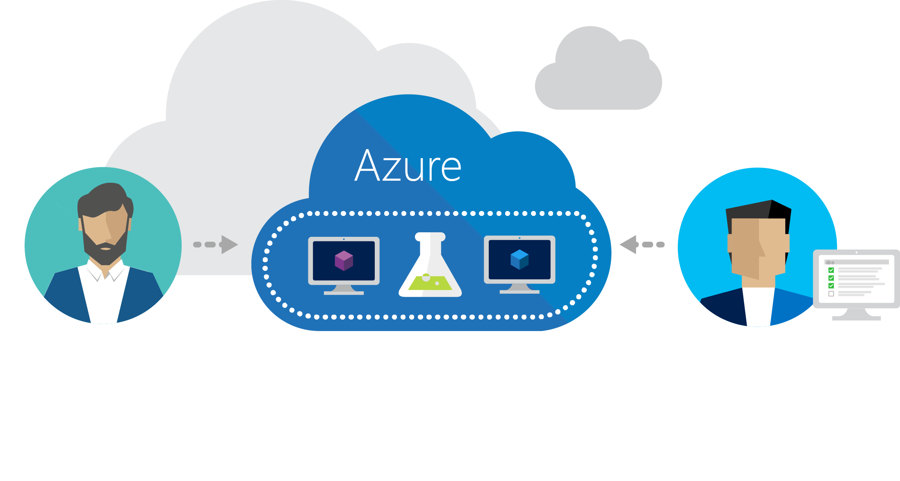
Azure DevTest Labs
Fast, easy, and lean dev-test environments in Azure.
Specifically for your team. On demand.

Slide 3
Demo

Slide 4

colinb@Microsoft.com
© 2016 Microsoft Corporation. All rights reserved. Microsoft, Windows, Windows Vista and other product names are or may be registered trademarks and/or trademarks in the U.S. and/or other countries.
The information herein is for informational purposes only and represents the current view of Microsoft Corporation as of the date of this presentation. Because Microsoft must respond to changing market conditions, it should not be interpreted to be a commitment on the part of Microsoft, and Microsoft cannot guarantee the accuracy of any information provided after the date of this presentation. MICROSOFT MAKES NO WARRANTIES, EXPRESS, IMPLIED OR STATUTORY, AS TO THE INFORMATION IN THIS PRESENTATION.

Slide 5
Create a Lab

Slide 6
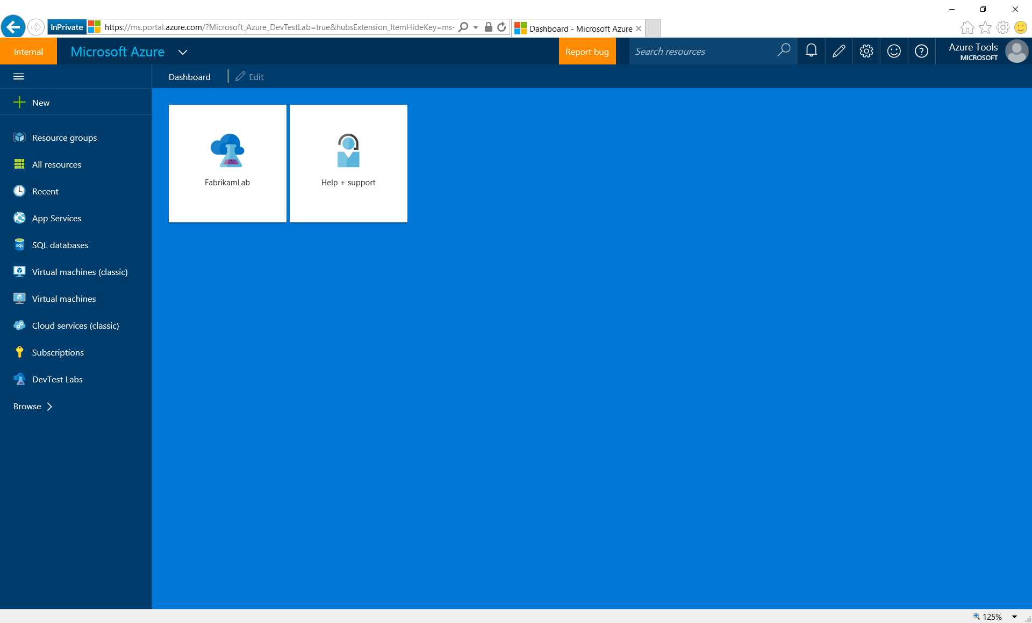
Notes:
Start from the Azure portal…

Slide 7
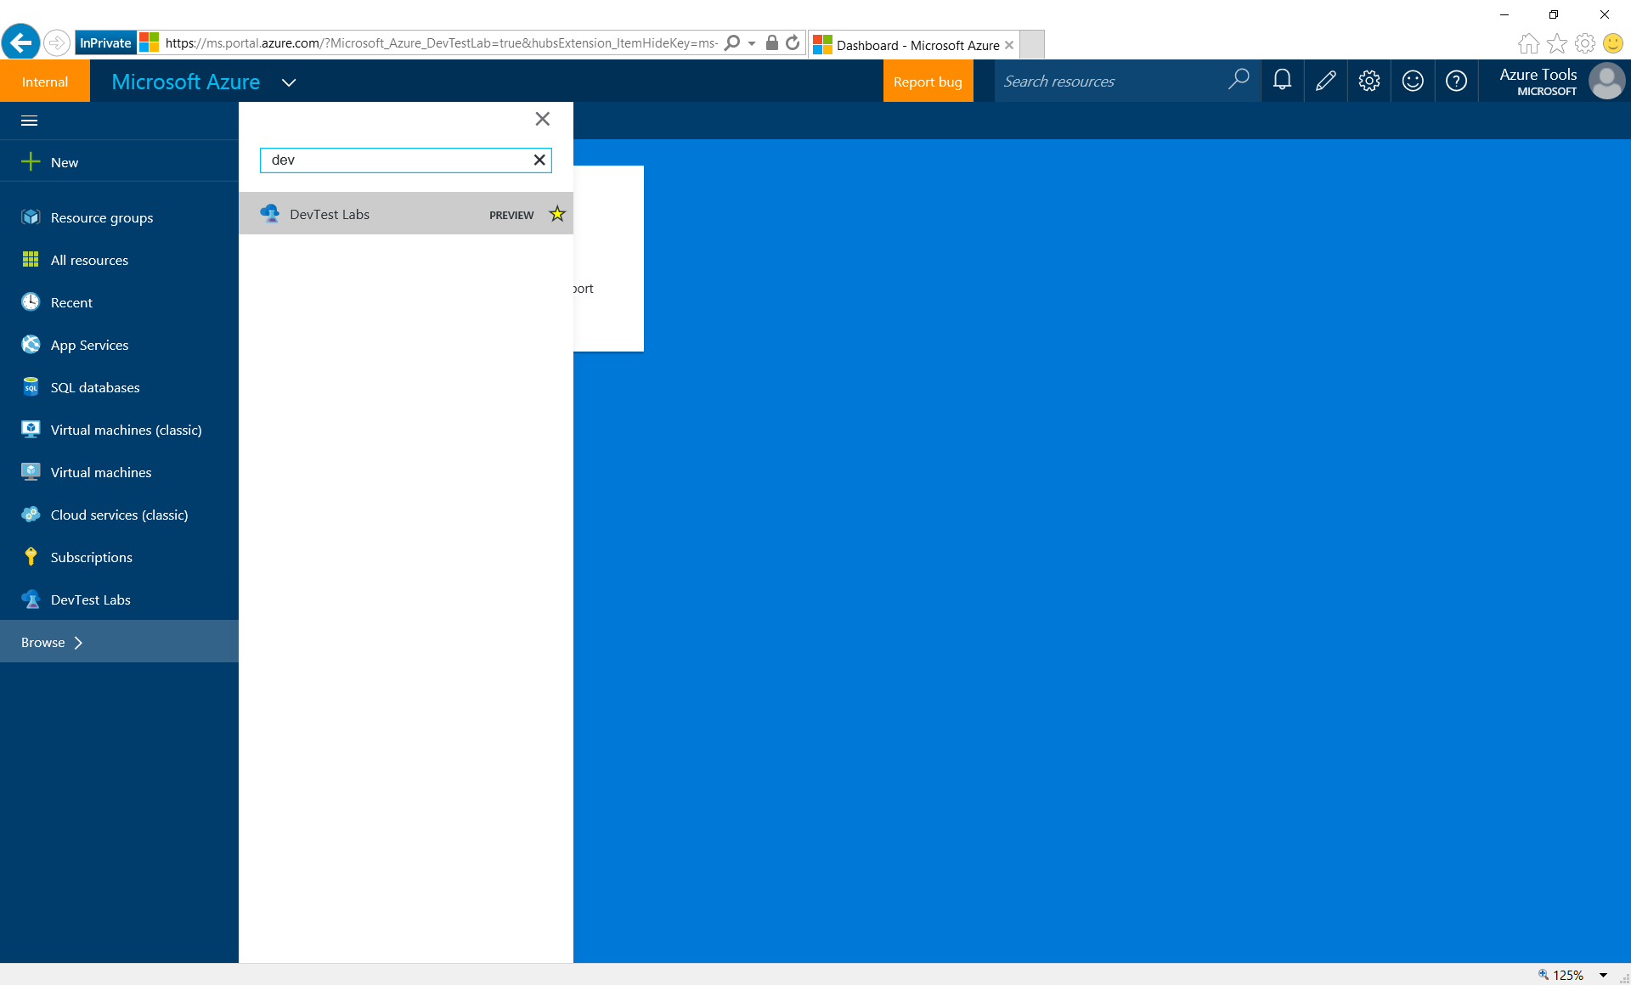
Notes:
In Browse, search for the DevTest Labs to open the Labs blade. You can pin it on the quick start navigation menu on the left.

Slide 8
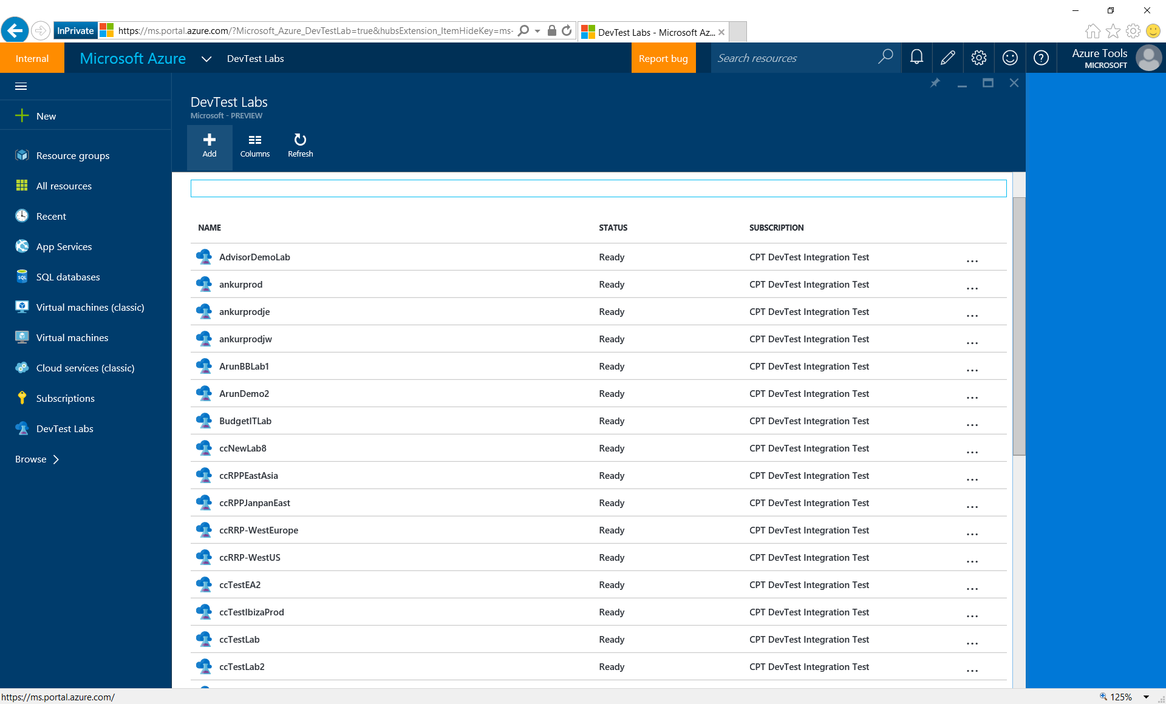
Notes:
Create a new lab by clicking the Add button on the top.

Slide 9
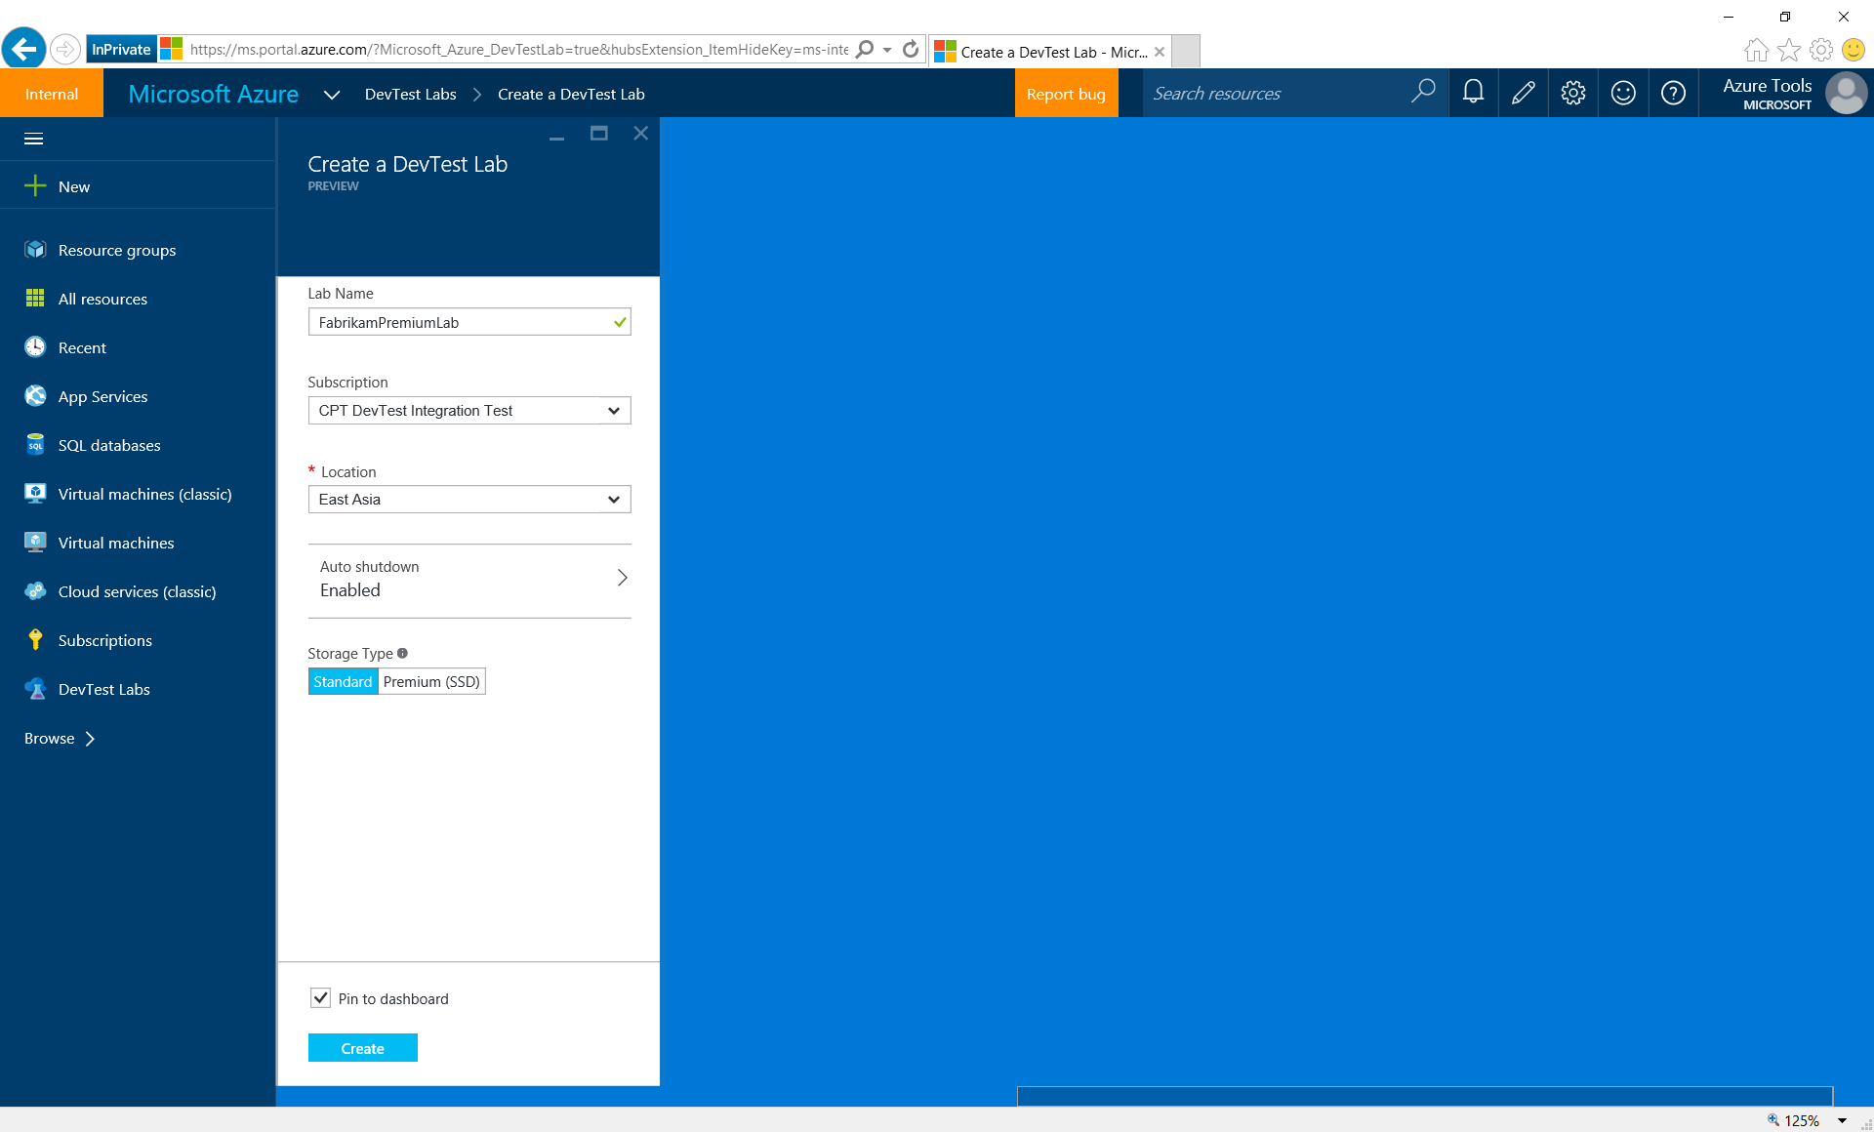
Notes:
Fill in the basic info…

Slide 10
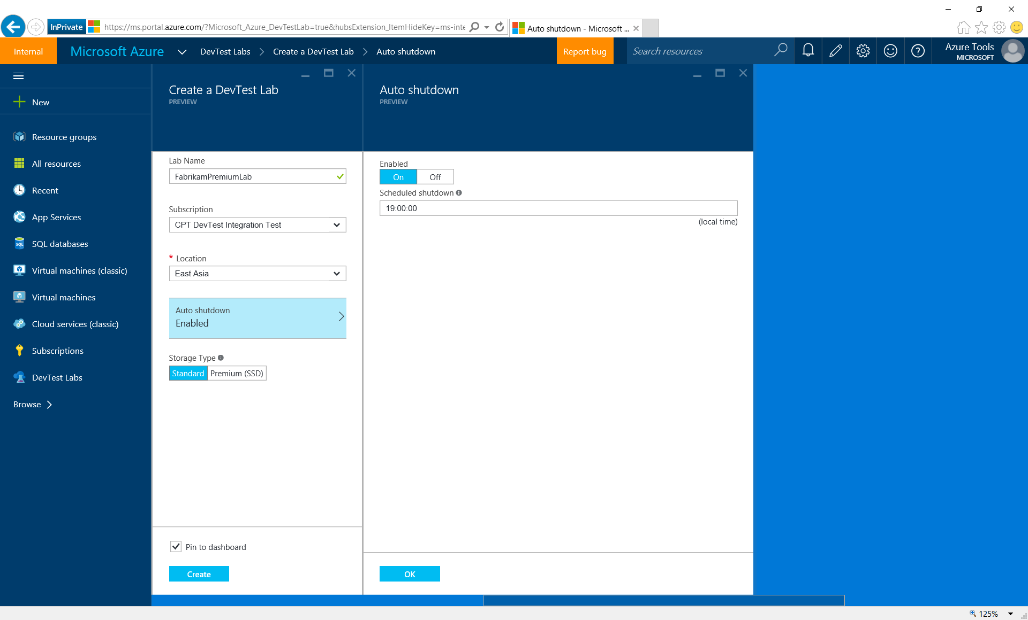
Notes:
By default, auto-shutdown policy is on when creating a lab, but can be updated.

Slide 11

Notes:
Labs can be created with either standard or premium storage. Premium storage gives VMs better performance, which is ideal for databases or powerful Dev machines. E.g. the normal reboot time for a Windows VM using premium storage can be just around 1 minutes.

Slide 12
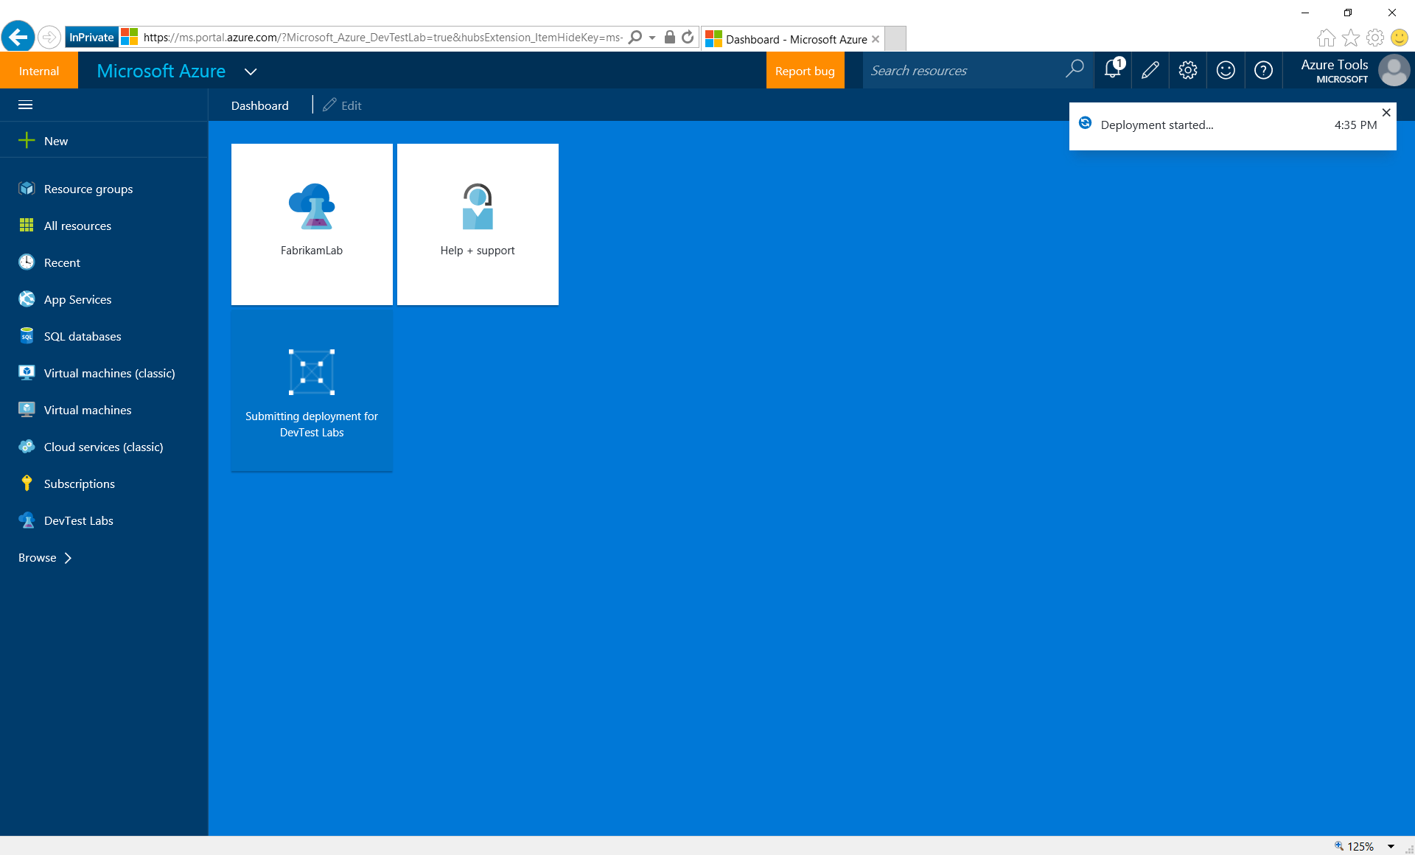
Notes:
Lab creation is in progress. A tile is auto-created at the Azure dashboard.

Slide 13
a couple of minutes later…

Slide 14
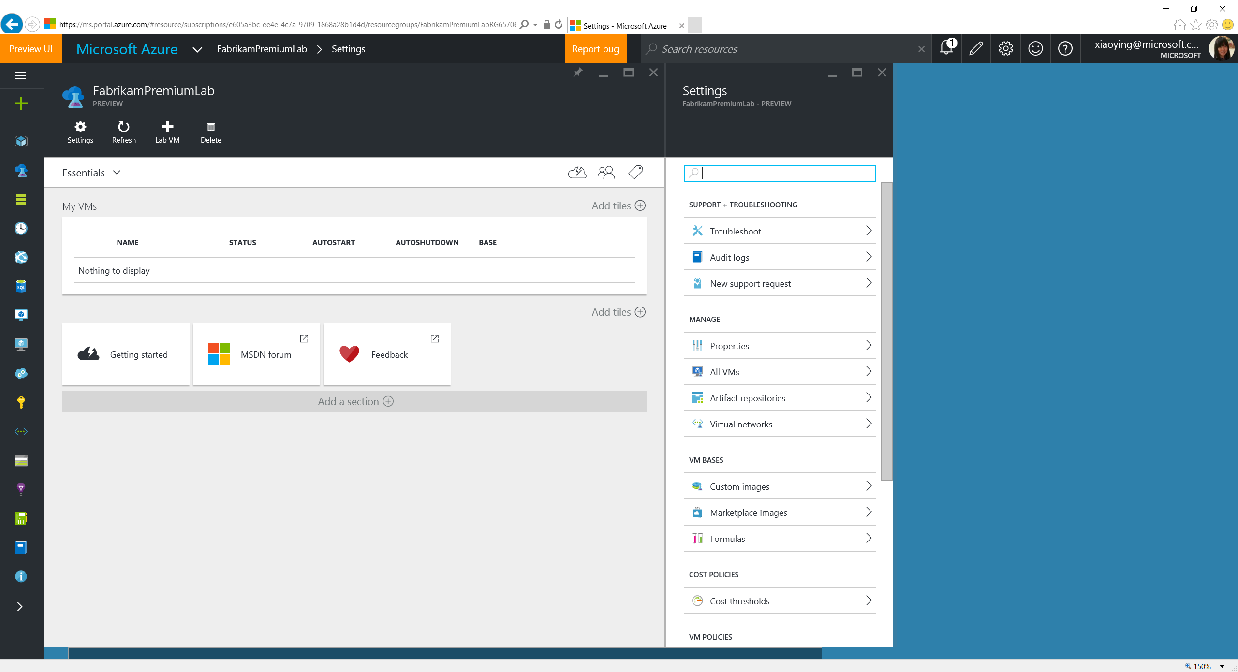
Notes:
In a couple of minutes, a new lab is created and ready to use.

Slide 15
Set Policies

Slide 16
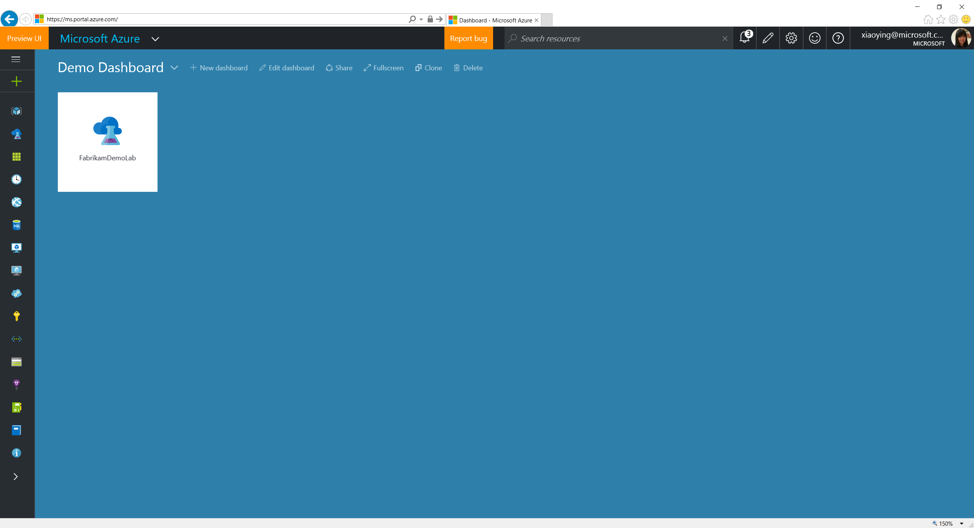
Notes:
Click a lab tile on the dashboard (if pinned) from the Azure dashboard (or select from the lab blade).

Slide 17
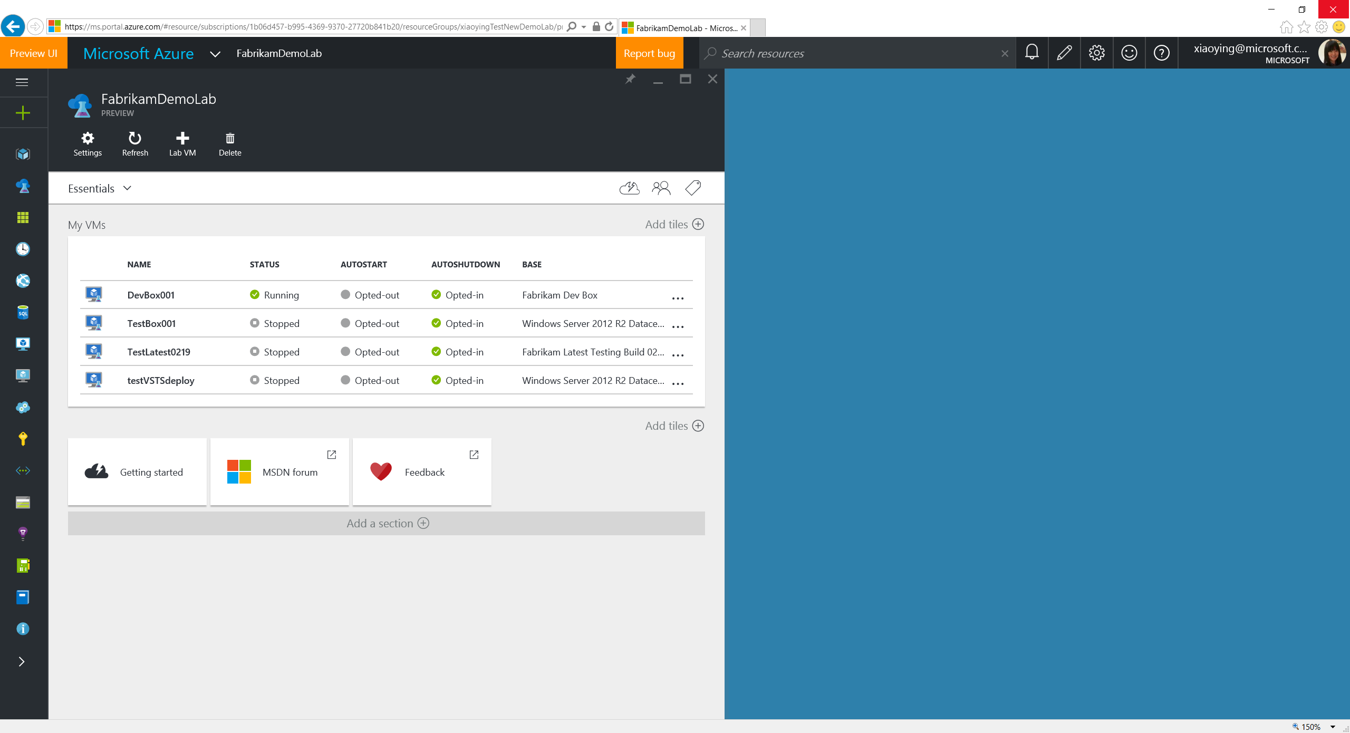
Notes:
Settings blade is opened automatically when opening a lab blade, which contains all the policy settings.

Slide 18
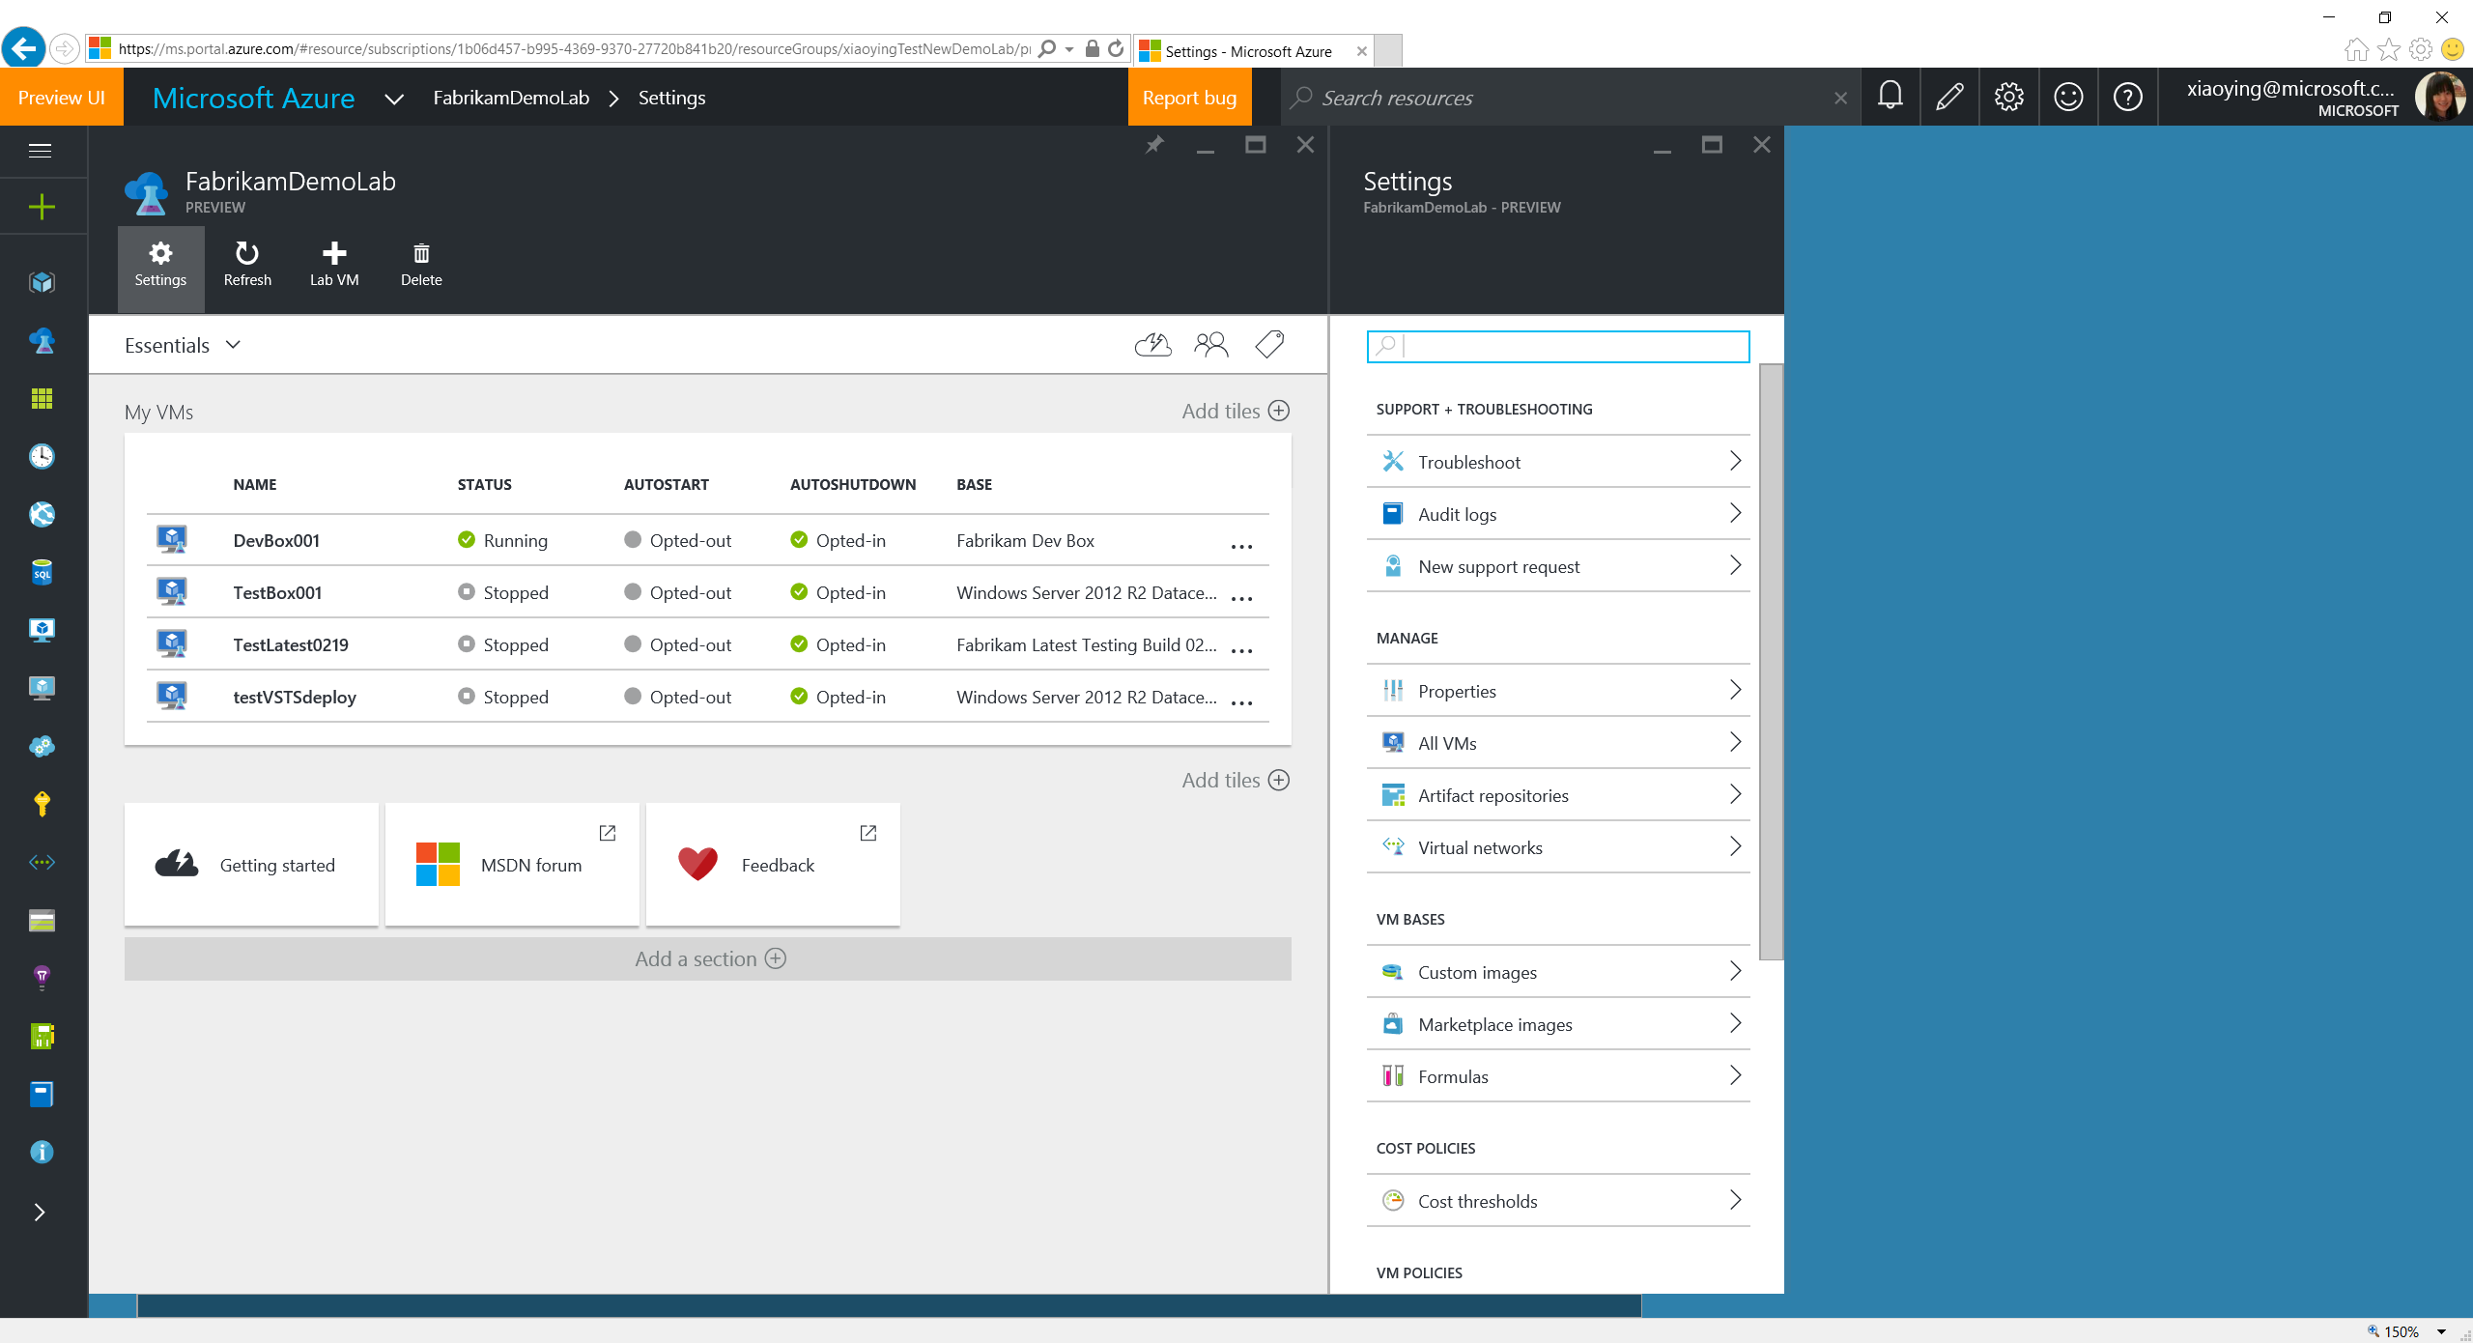

Slide 19
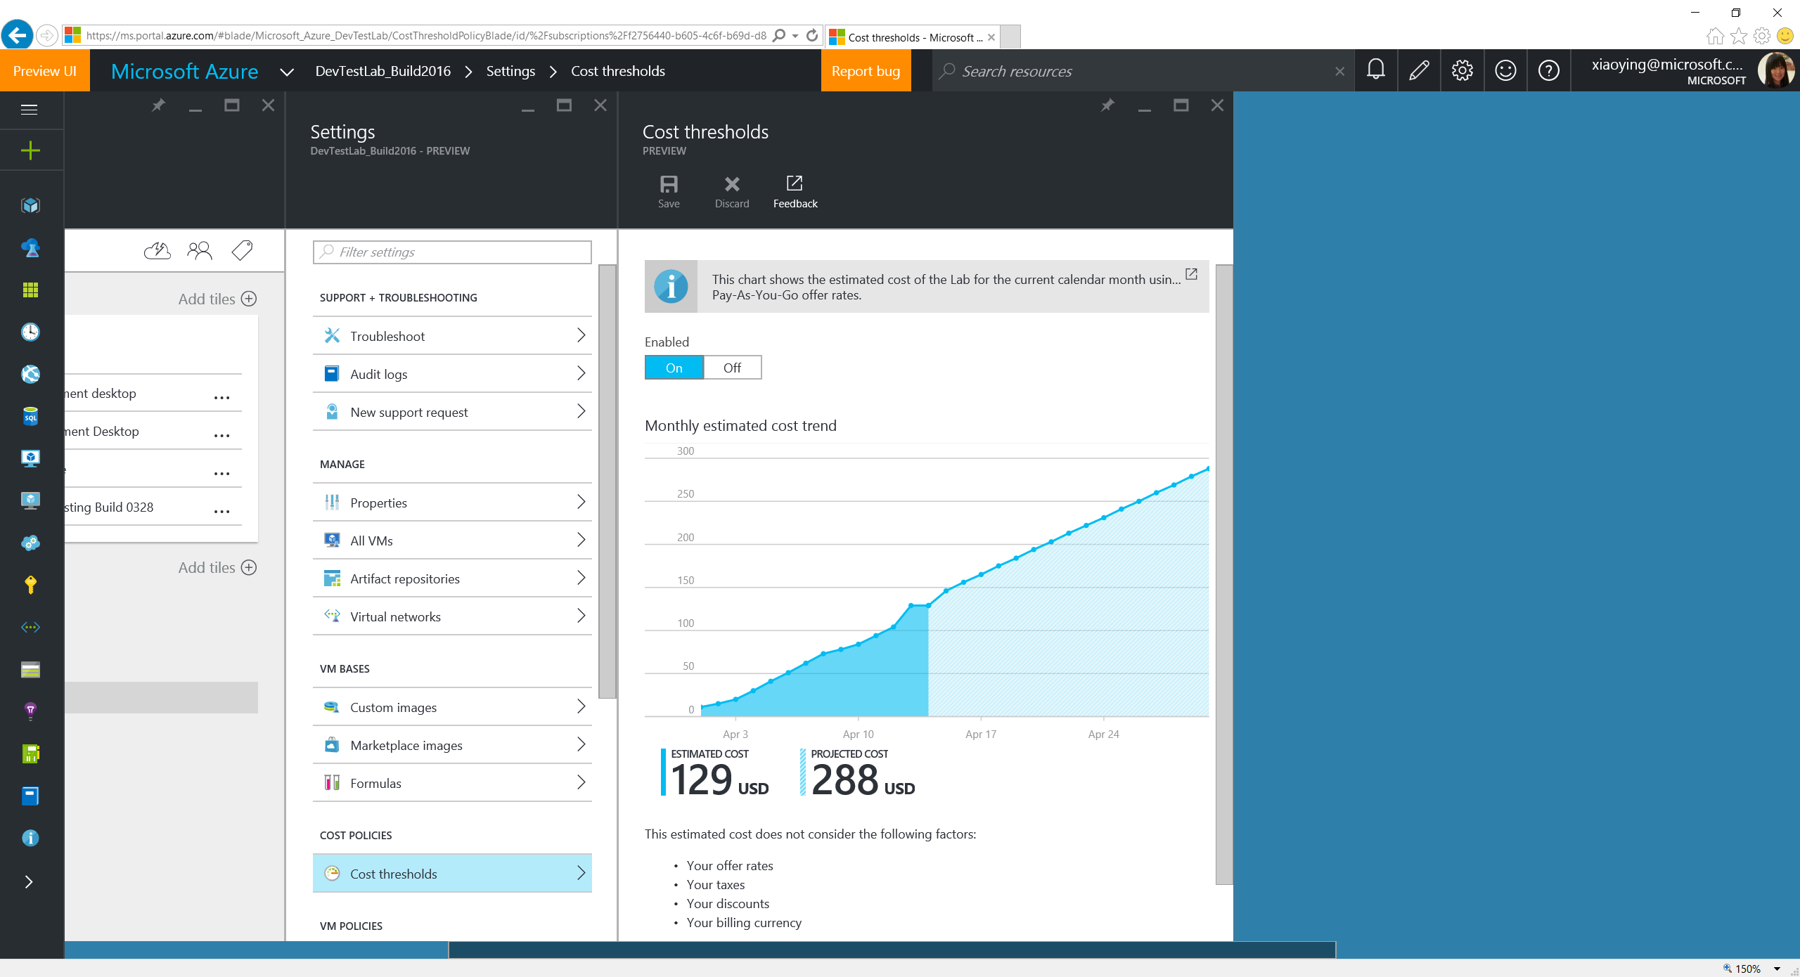
Notes:
As the 1st iteration, Cost Threshold shows the cost trending chart based on the resource usage in the lab, and offers a projection based on the current spending.

Slide 20
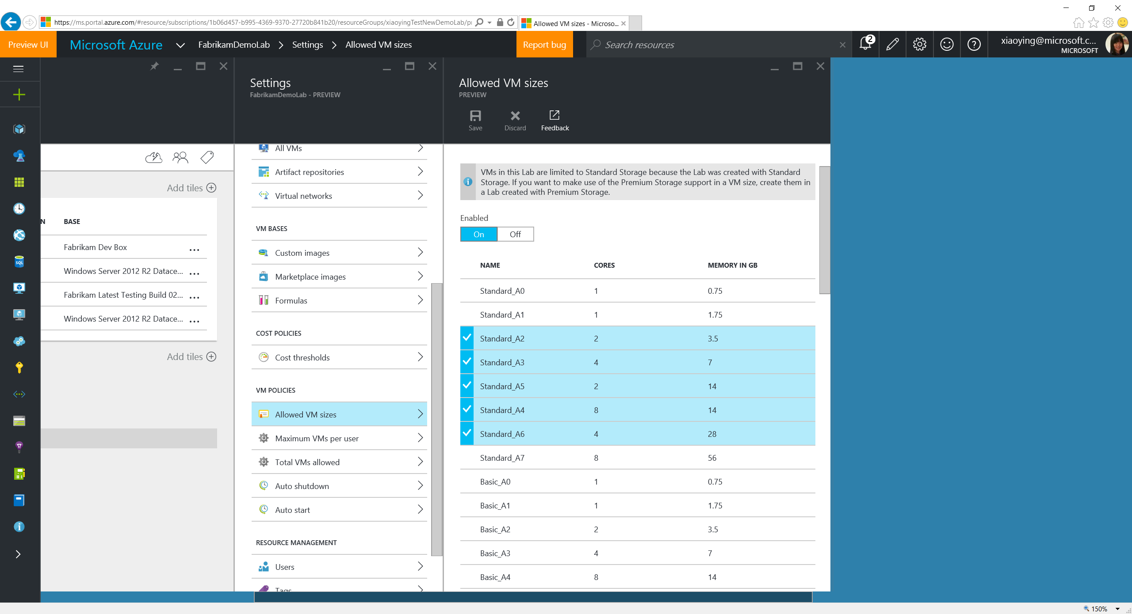
Notes:
Allowed VM Sizes allows to pick a list of VM sizes that lab users can choose when creating VMs in the lab.

Slide 21
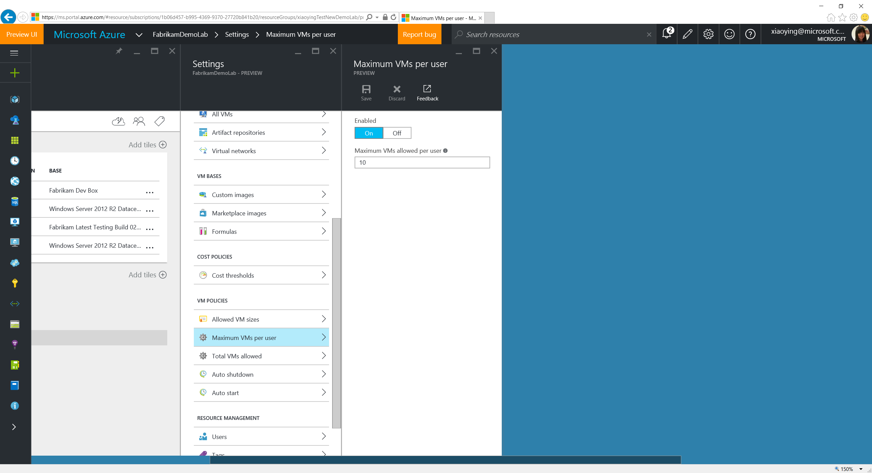
Notes:
Maximum VMs Per User allows to set a threshold on the # of VMs each lab users can create.

Slide 22
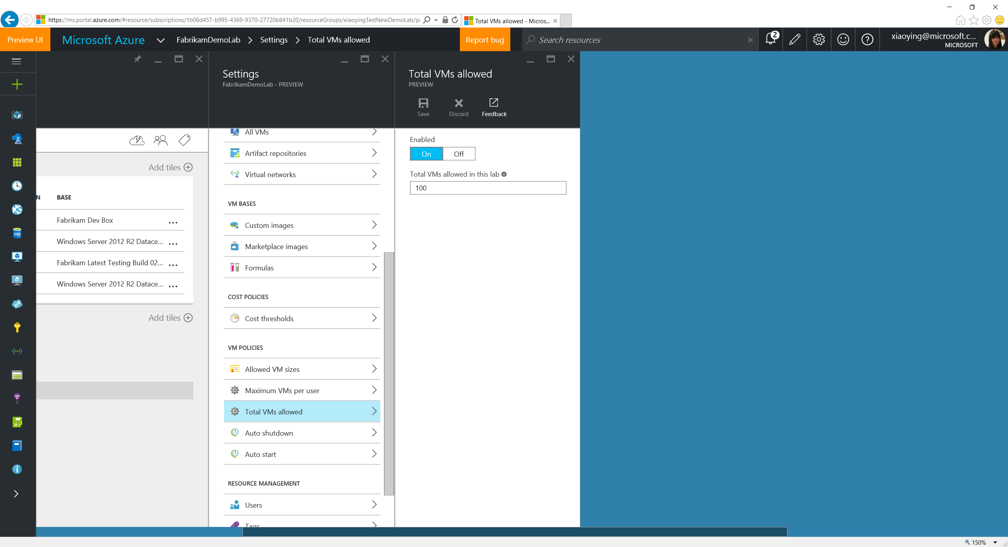
Notes:
Total VMs Allowed allows to set threshold on the total # of VMs that can be created within the lab.

Slide 23
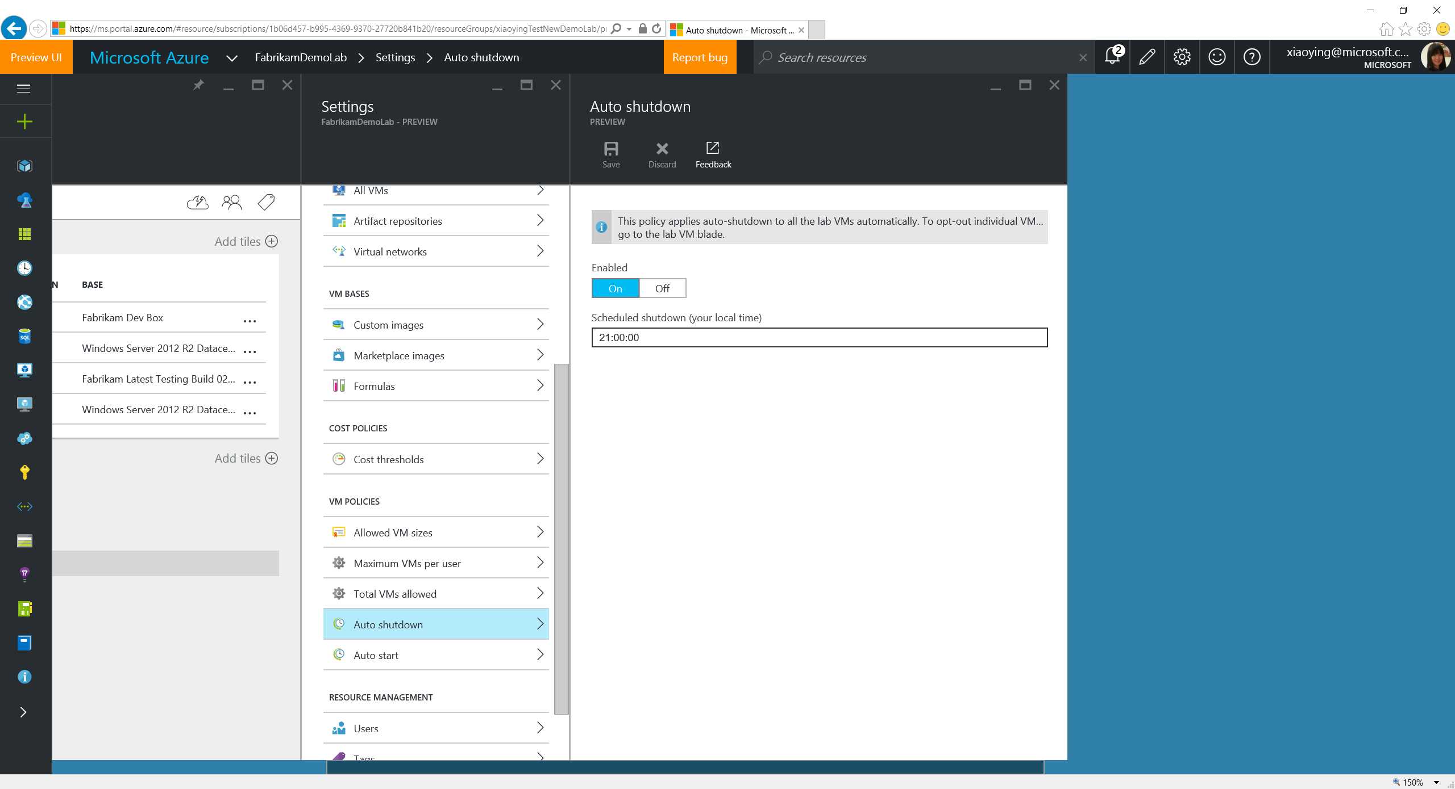
Notes:
Auto Shutdown allows to set a time when all the VMs in the lab (except opt-out ones) will be shutdown so as to reduce the spending.

Slide 24
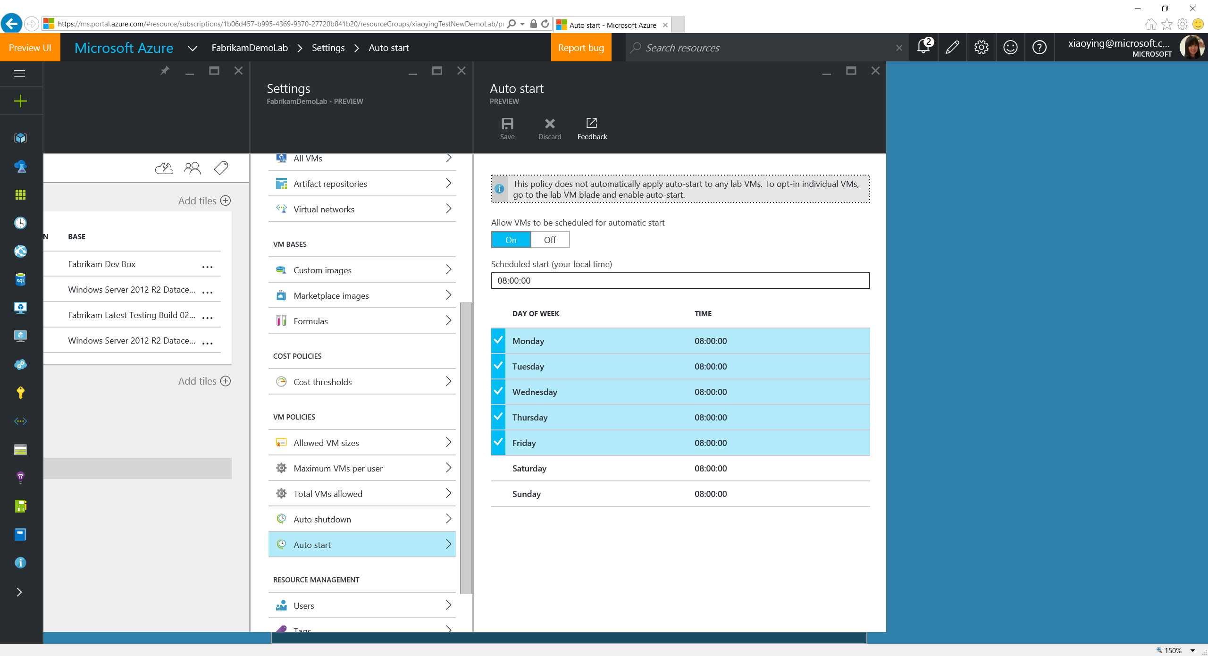
Notes:
Auto Start allows VMs in the lab to opt-in automatic start based on the specified time and the days. It allows the VMs to be ready for use automatically before the lab users start their work.

Slide 25
Set Virtual Networks

Slide 26
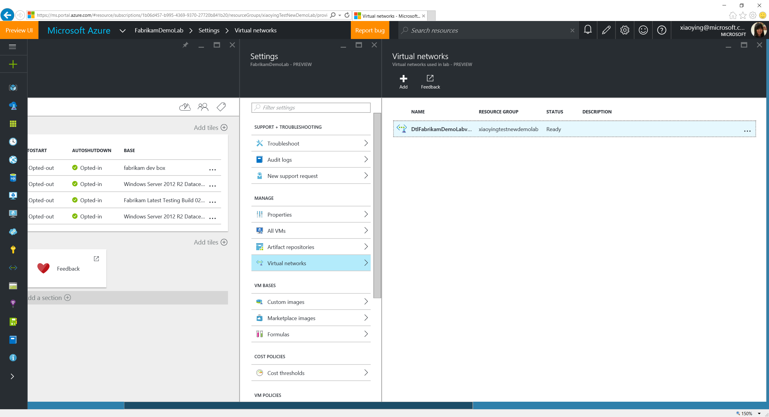

Slide 27
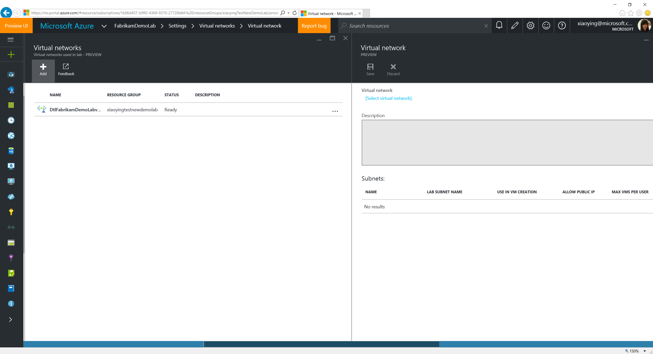
Notes:
Existing VNET in the subscription can be added into the lab for the lab users to use when they create a lab VM.

Slide 28
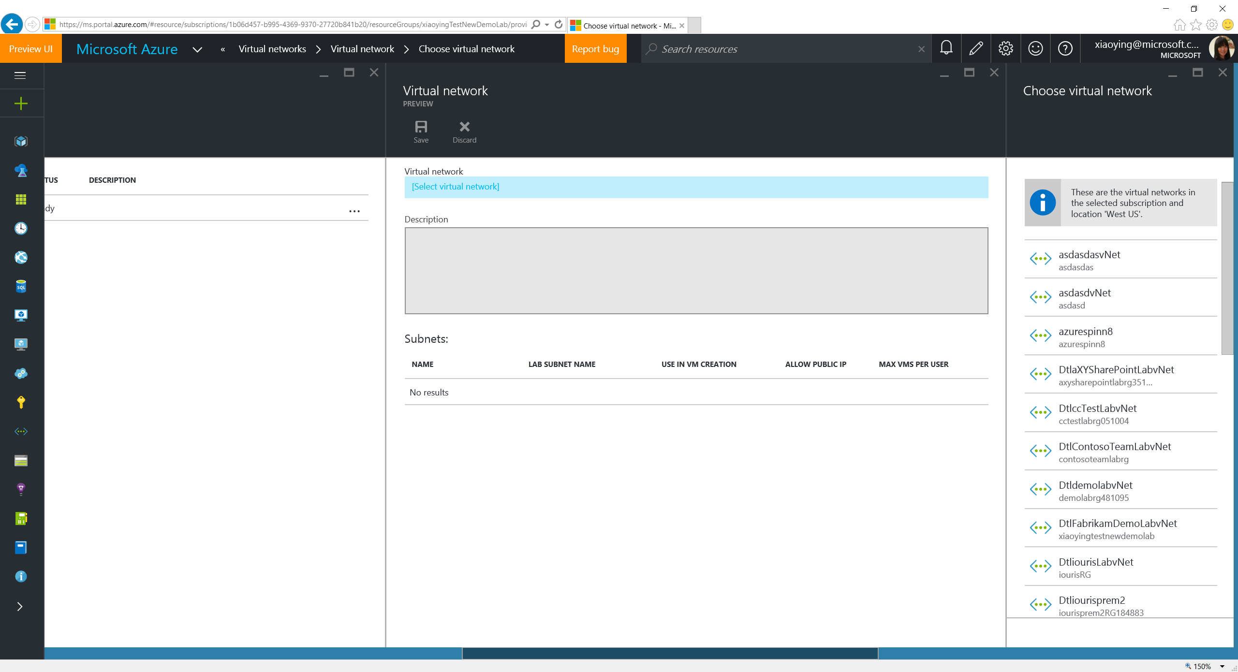
Notes:
Qualified VNET in the subscription can be added into the lab as long as it meets the following criteria:
In the same subscription.
In the same region.
The lab owner has the permission to access the VNET.

Slide 29
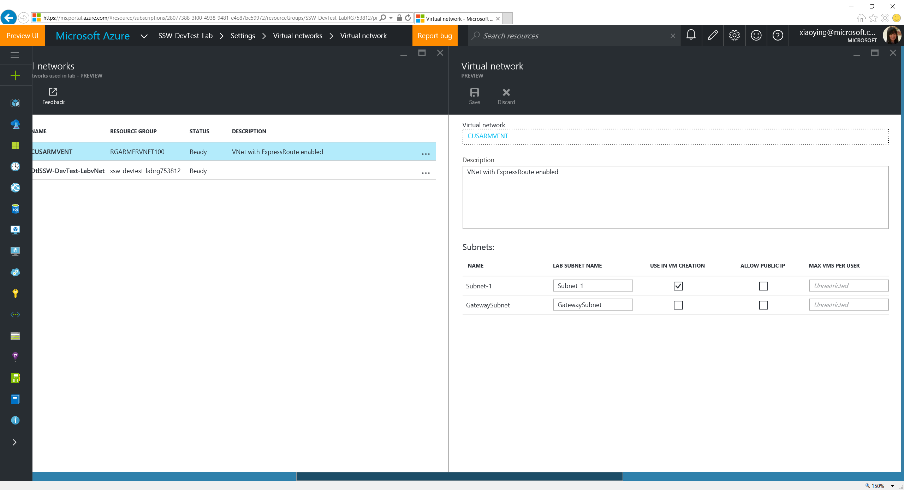
Notes:
Lab owner can define rules how the subnets in the VNET to be used, including whether it’s allowed for lab users to use when creating a VM, whether a public IP address is allowed to be added, and the maximum number of VMs allowed for each user in the subnet.

Slide 30
Configure Artifact Repositories

Slide 31
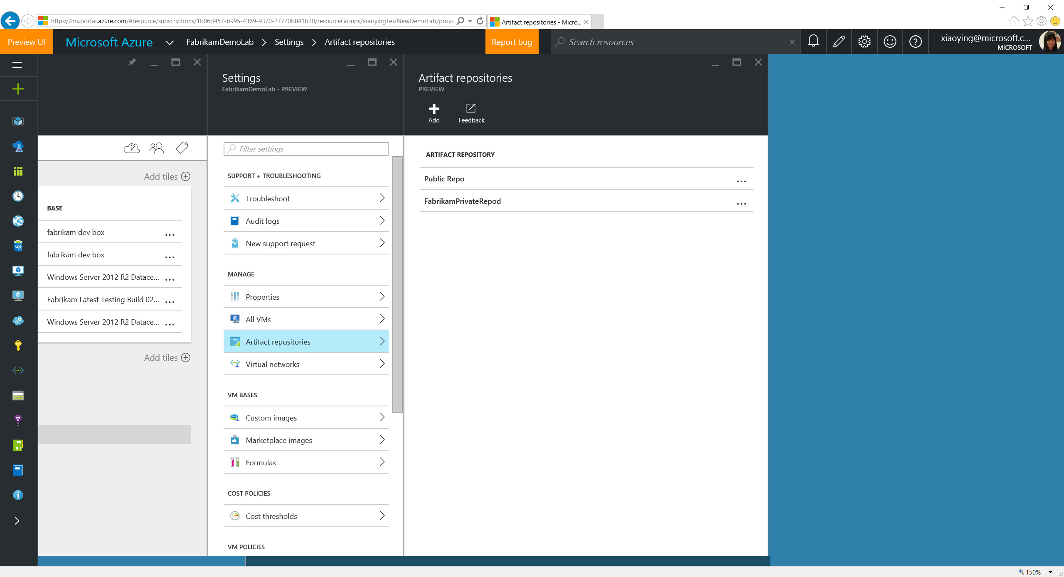
Notes:
At VM creation, Labs loads artifact files (which is defined in JSON format) from Git repos. It comes with a public GitHub repo, but private repo can also be added to feed more custom artifacts.

Slide 32
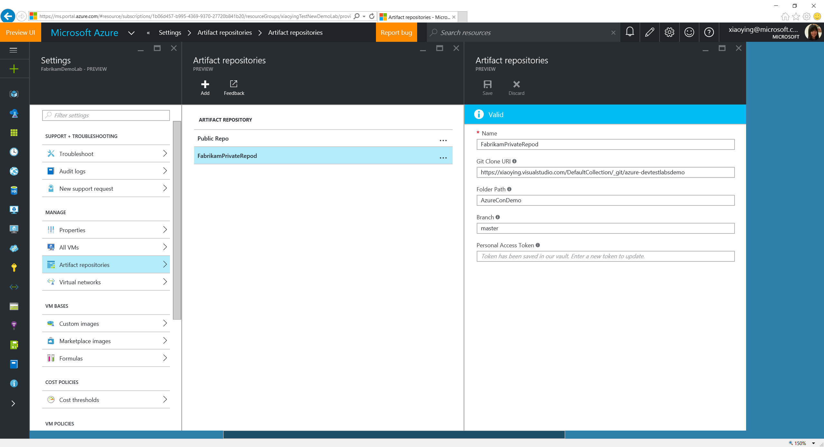
Notes:
Private repos can be added or updated through the lab Settings.

Slide 33
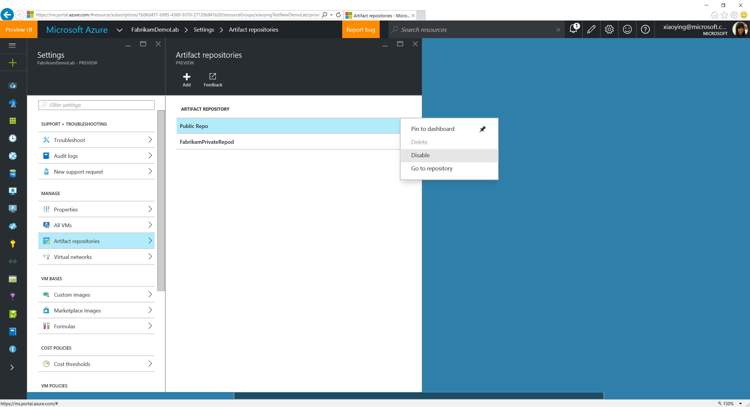
Notes:
If your compliance policy doesn’t allow any artifacts in Labs’ public repo, the Public Repo can be disabled through Settings. When it happens, a recommendation for better productivity is to browse the existing artifacts in the public repo, and copy that ones you need into the private repo and tweak them in a way that follows the compliance. You can also temporarily disable a private repo before it’s ready for lab users to use.

Slide 34
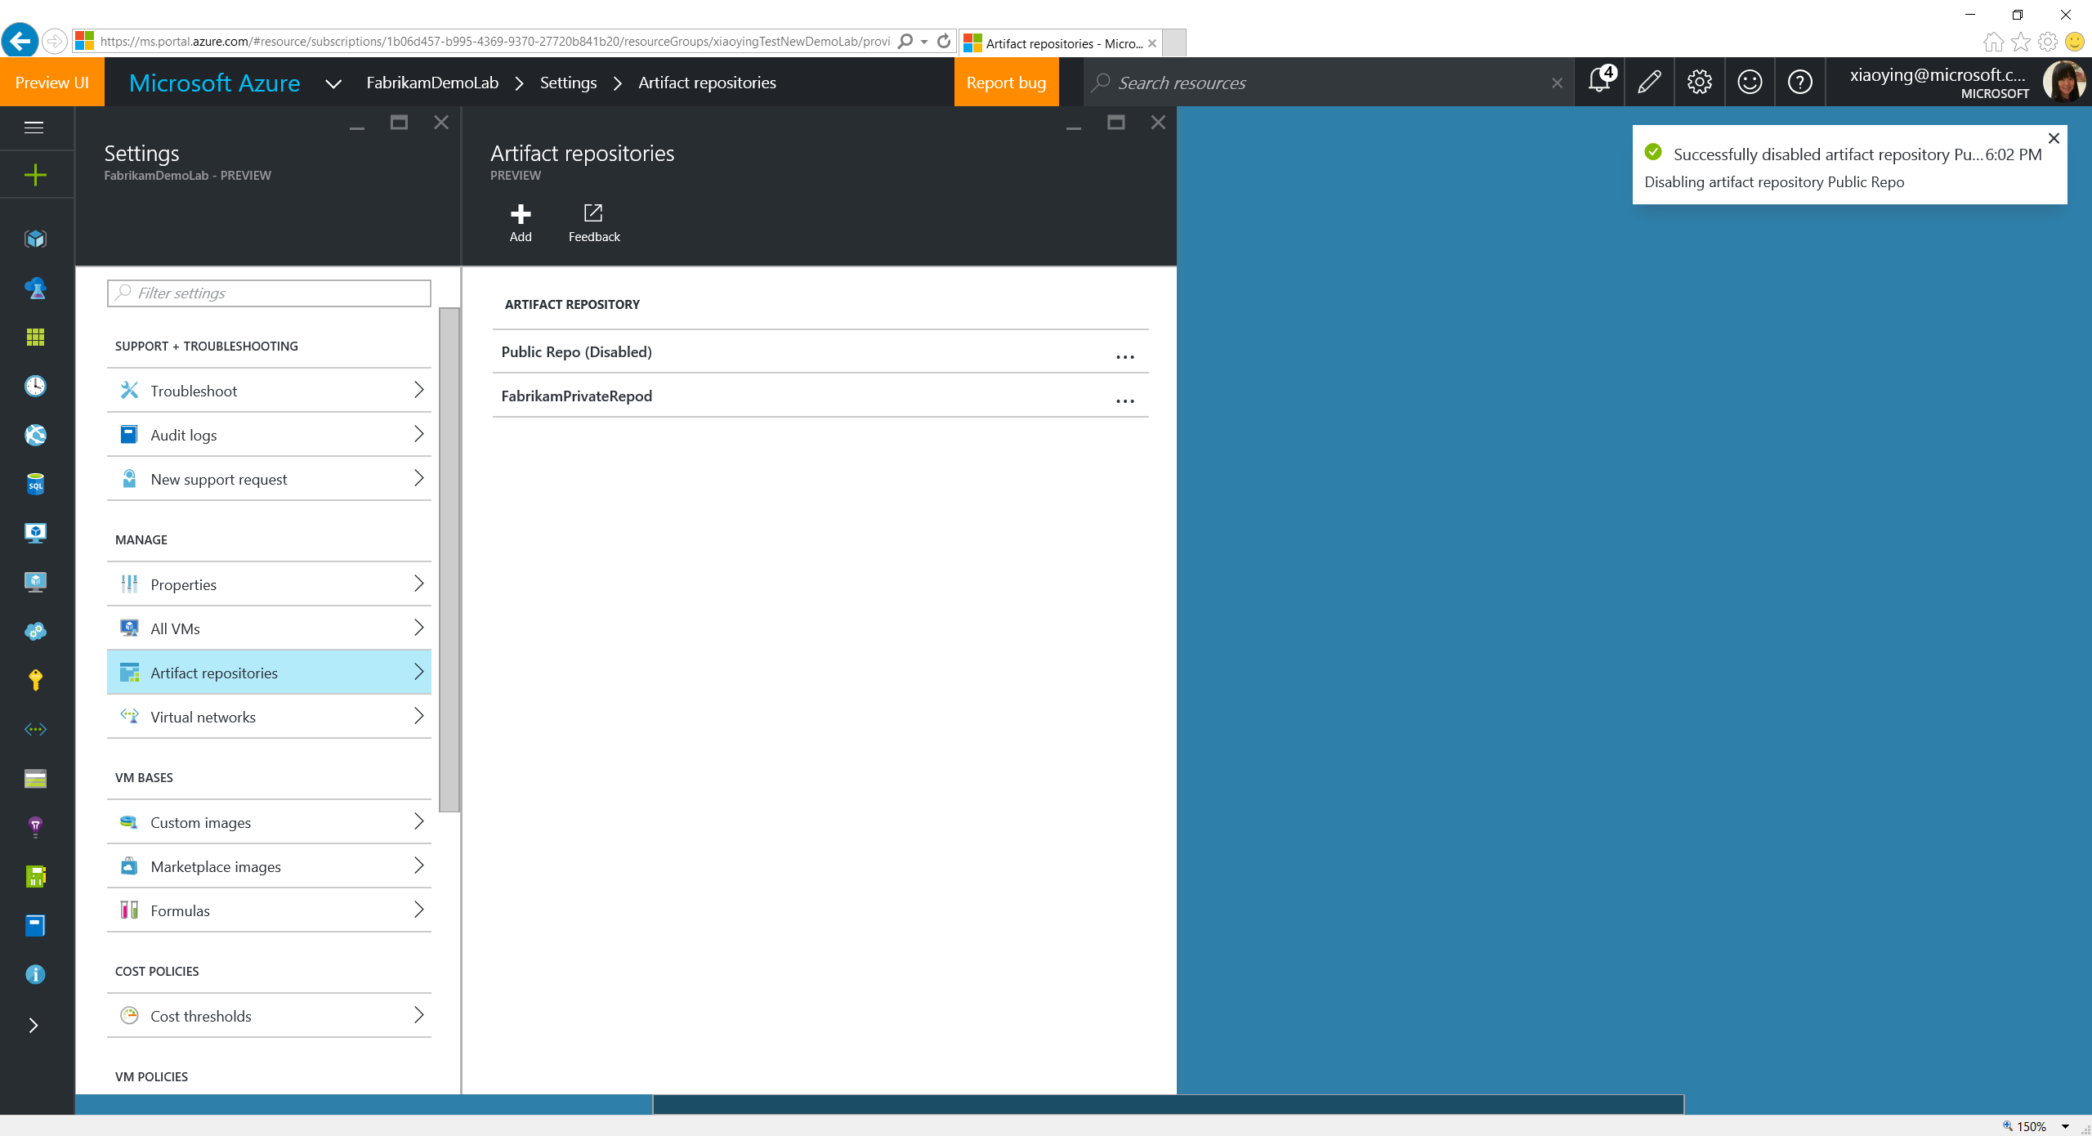
Notes:
The public repo is disabled.

Slide 35
Manage VM Bases

Slide 36
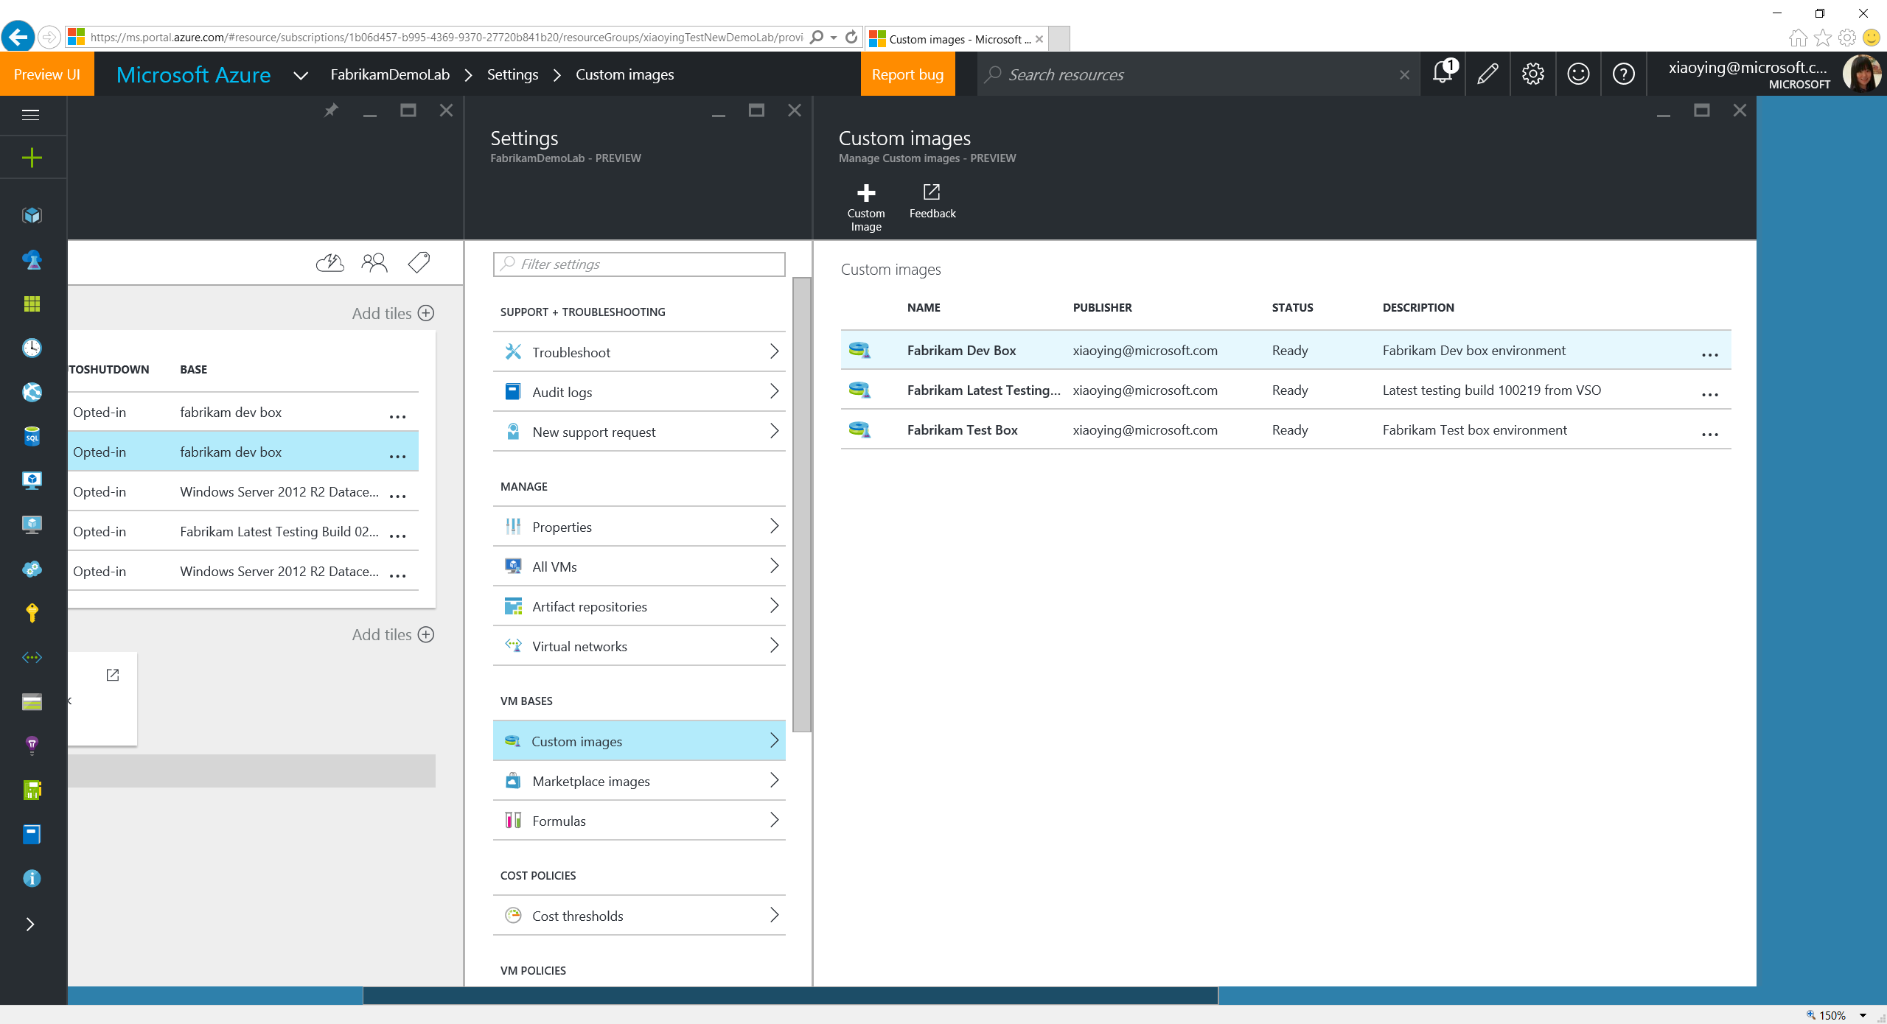
Notes:
VM Bases are used when creating a VM, including formulas, custom images and Azure Marketplace images. Formula is a template with pre-defined values to the lab VM creation settings. Custom images are from the VHDs added into the lab. Lab owner can whitelist Azure Marketplace images allowed to show up in the lab VM base.

Slide 37
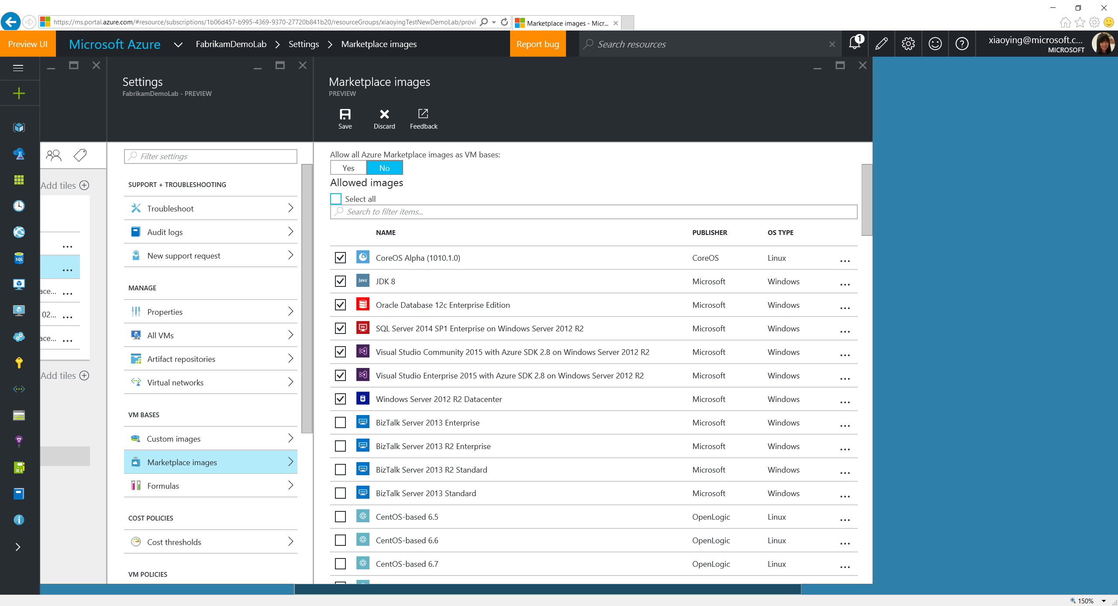
Notes:
Lab owners can whitelist marketplace images for the ones they want to allow in the lab for VM creation.

Slide 38
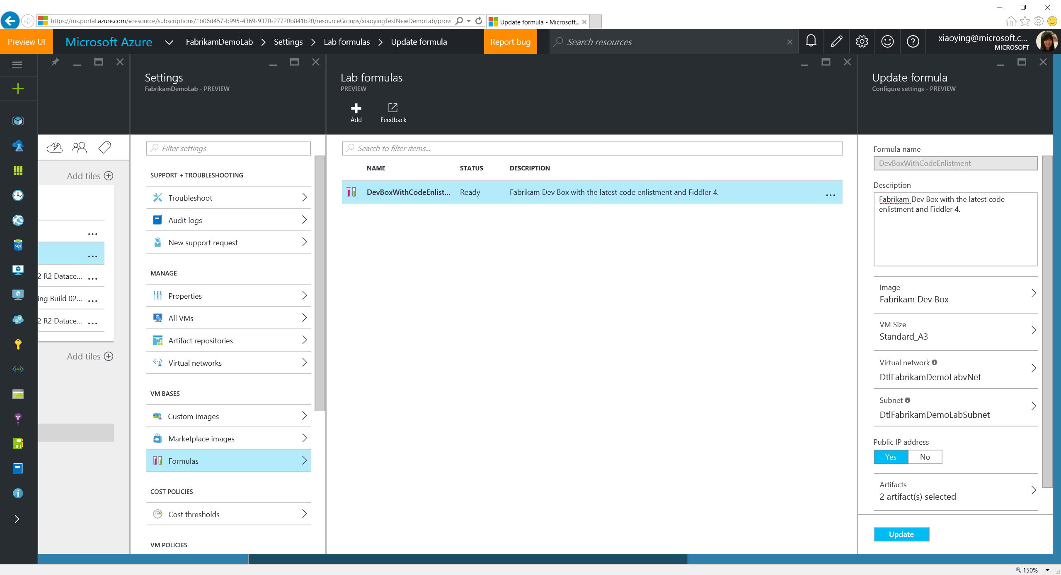
Notes:
Lab users can also create formulas from scratch and manage the existing ones.

Slide 39
Add Lab Users

Slide 40
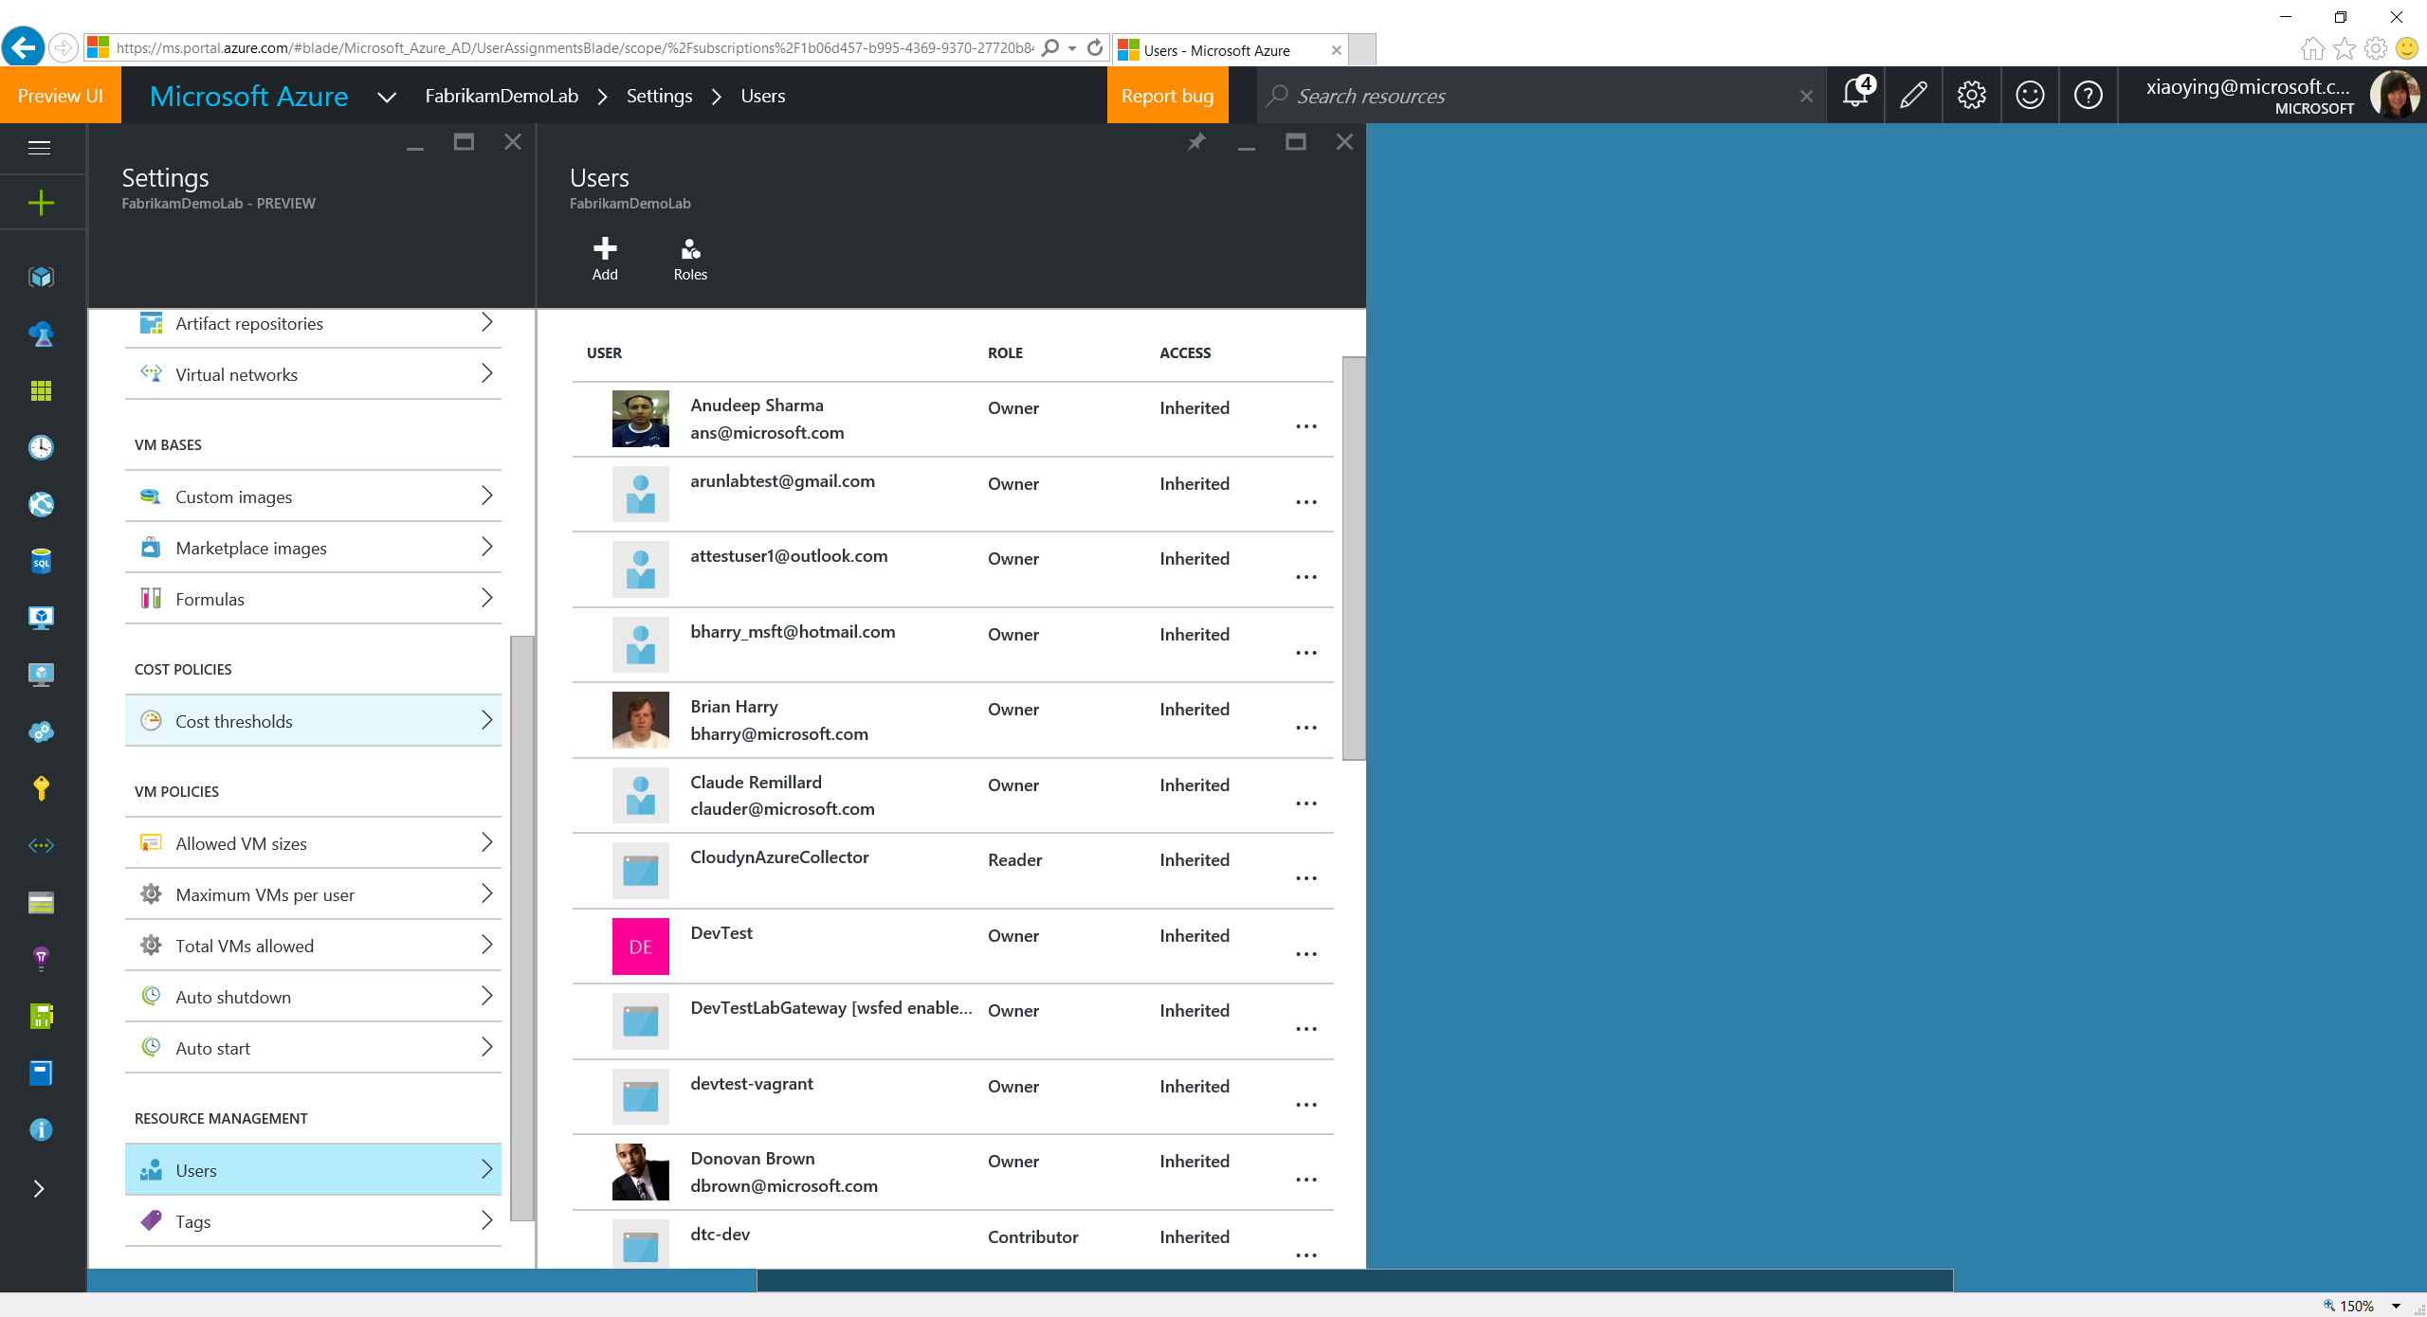
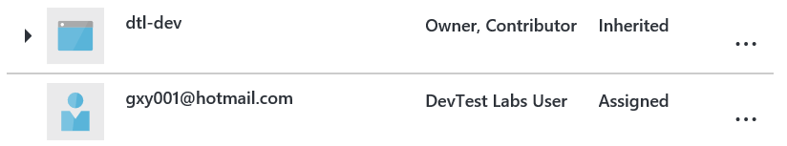
Notes:
Lab owner can add more users to the lab as a DevTest Labs user, who can only create VMs and manage their own VMs.

Slide 41
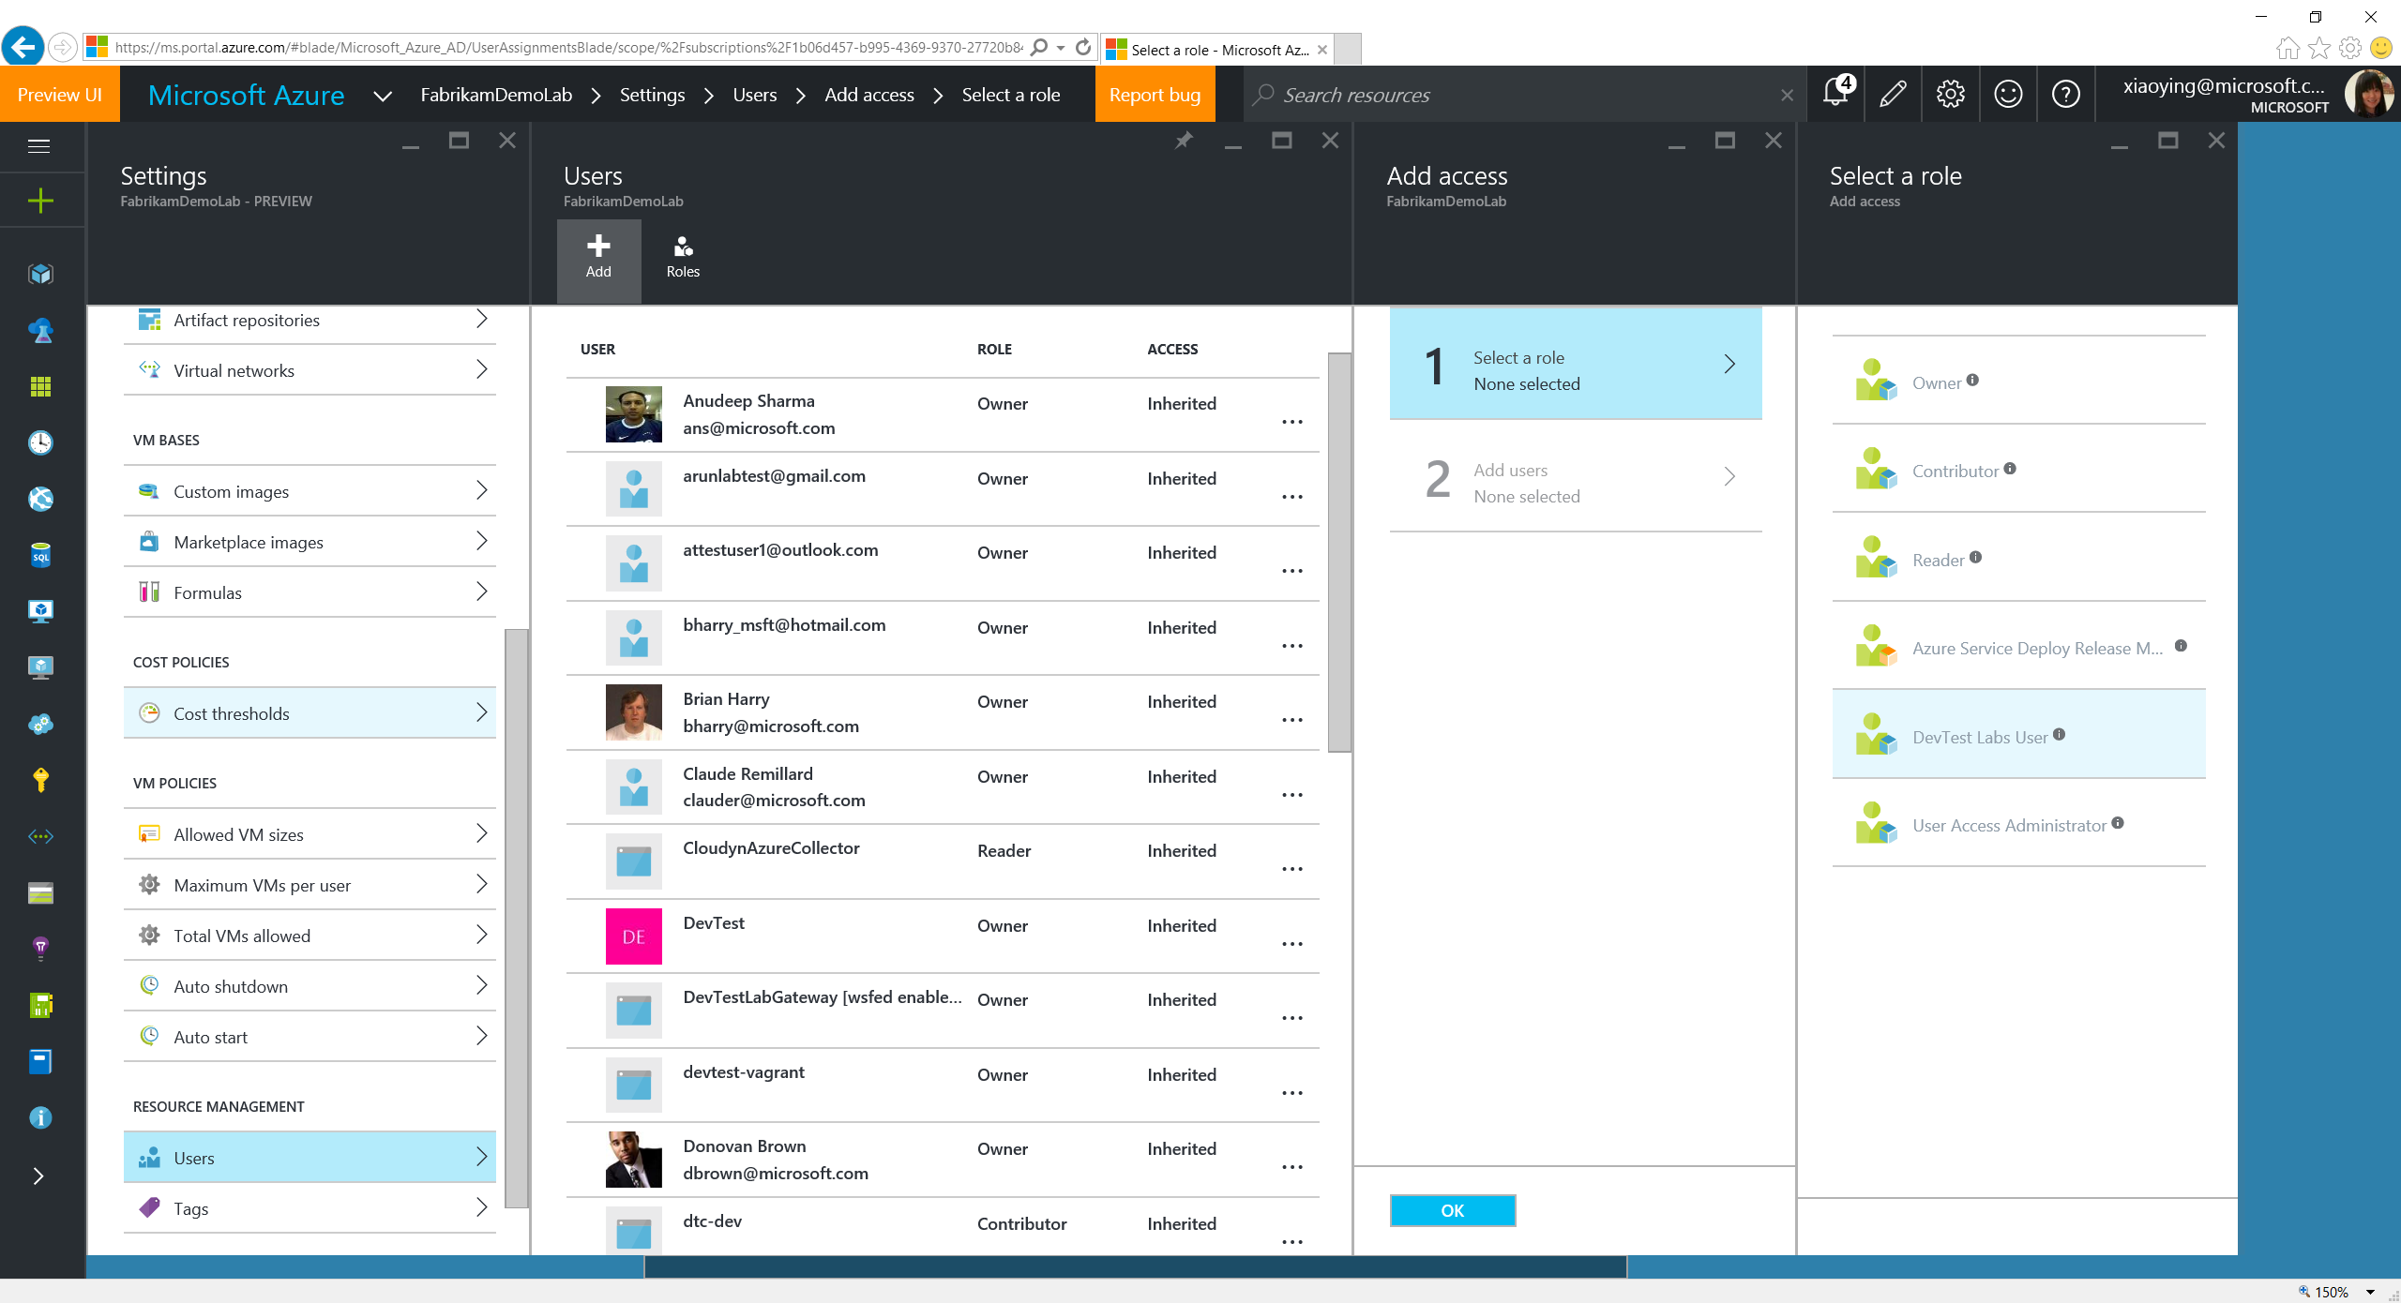
Notes:
Select “DevTest Labs Users” role.

Slide 42
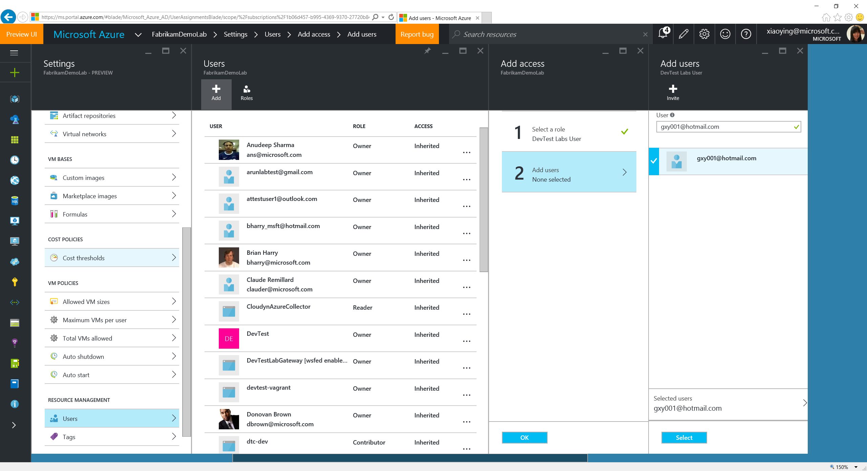
Notes:
Users are not necessarily to be in the Azure Active Directory, as long as they have a valid Microsoft account.

Slide 43
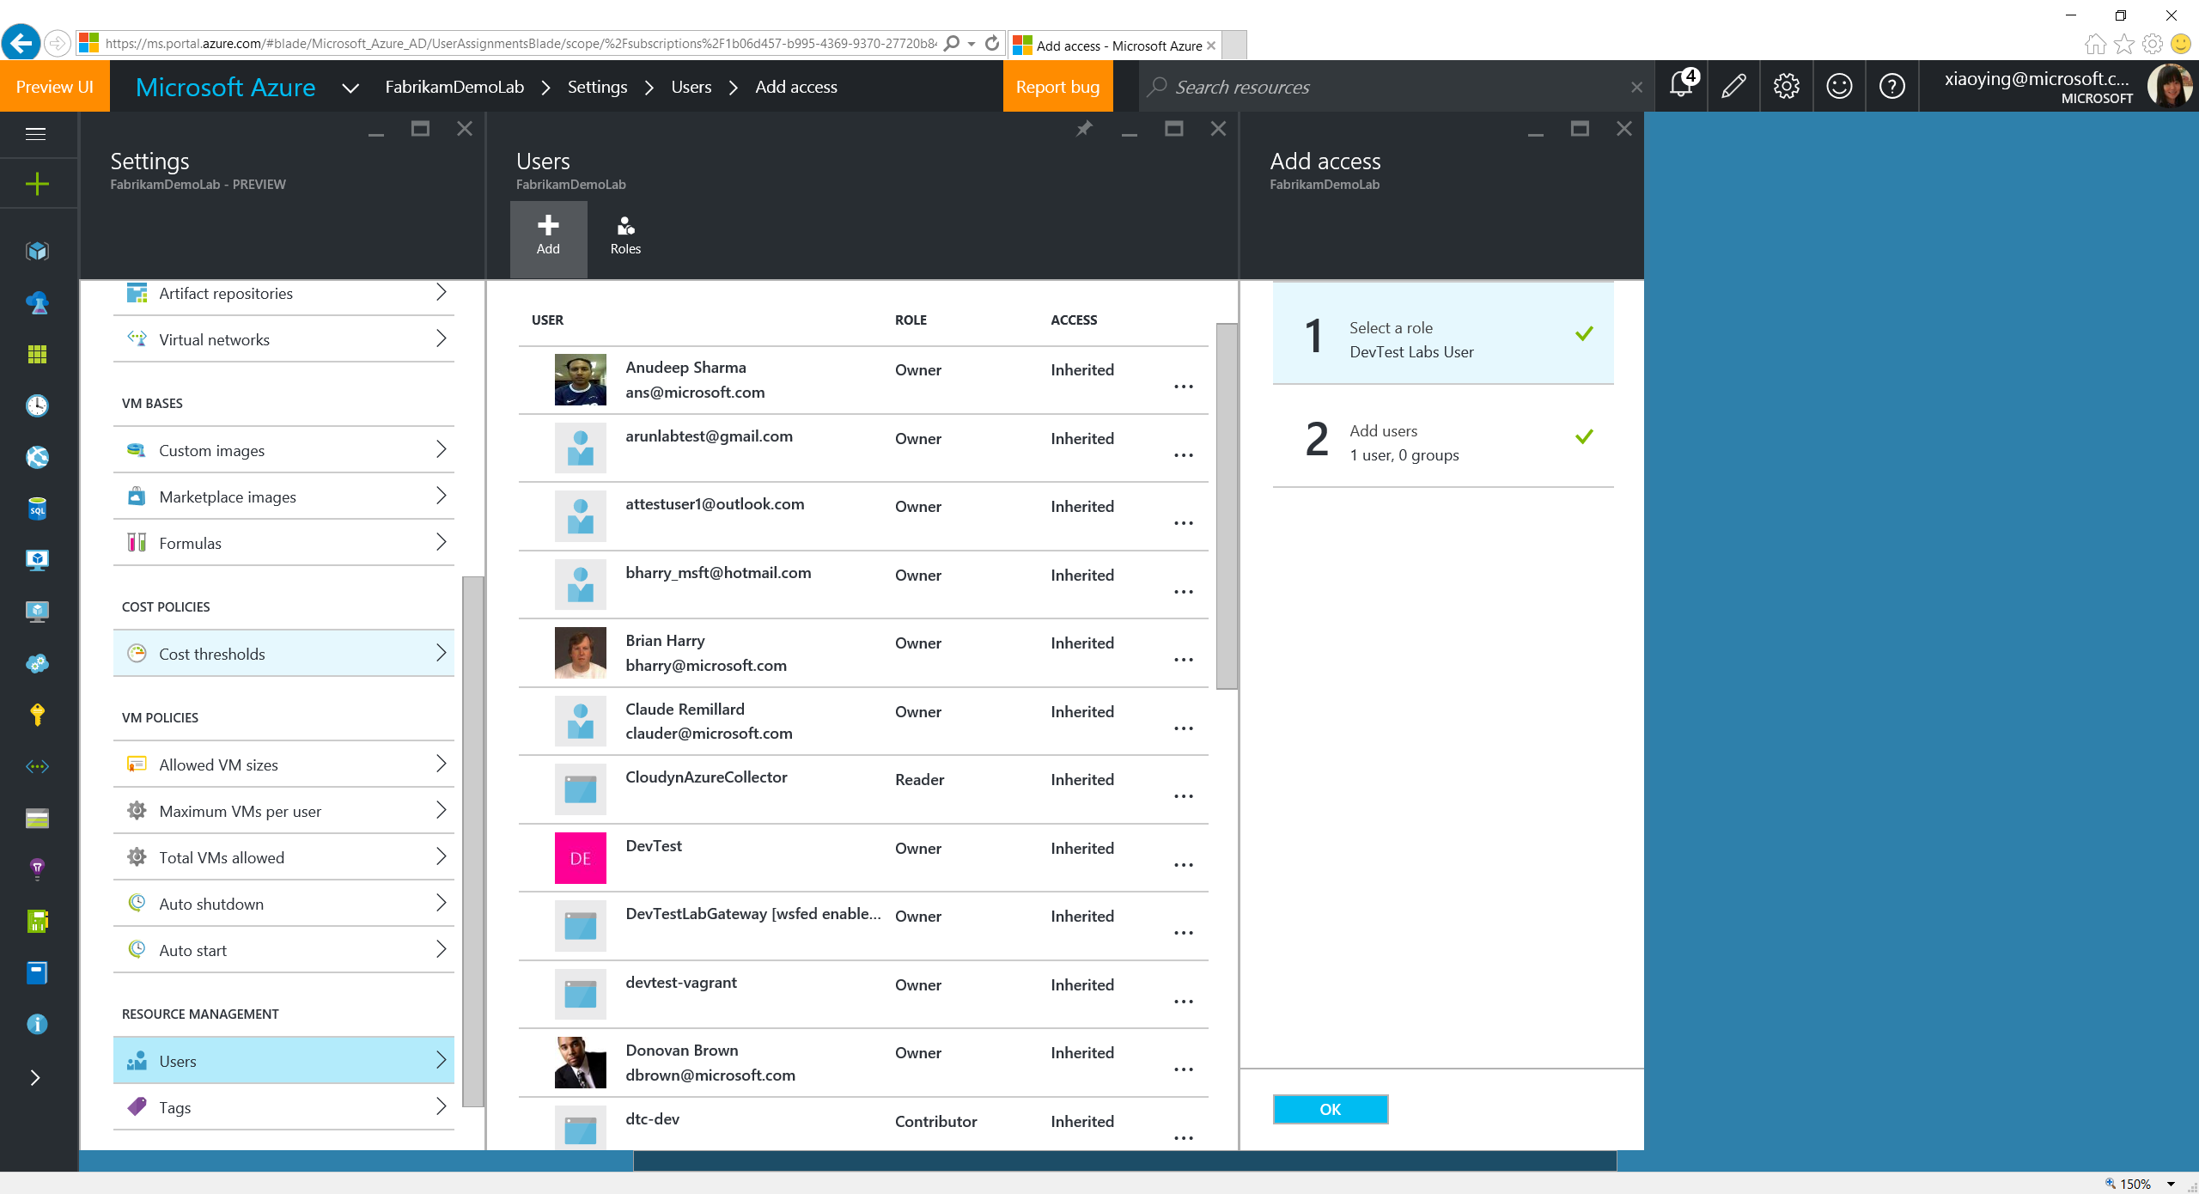
Notes:
Click OK to add the user as a DevTest Labs User.

Slide 44
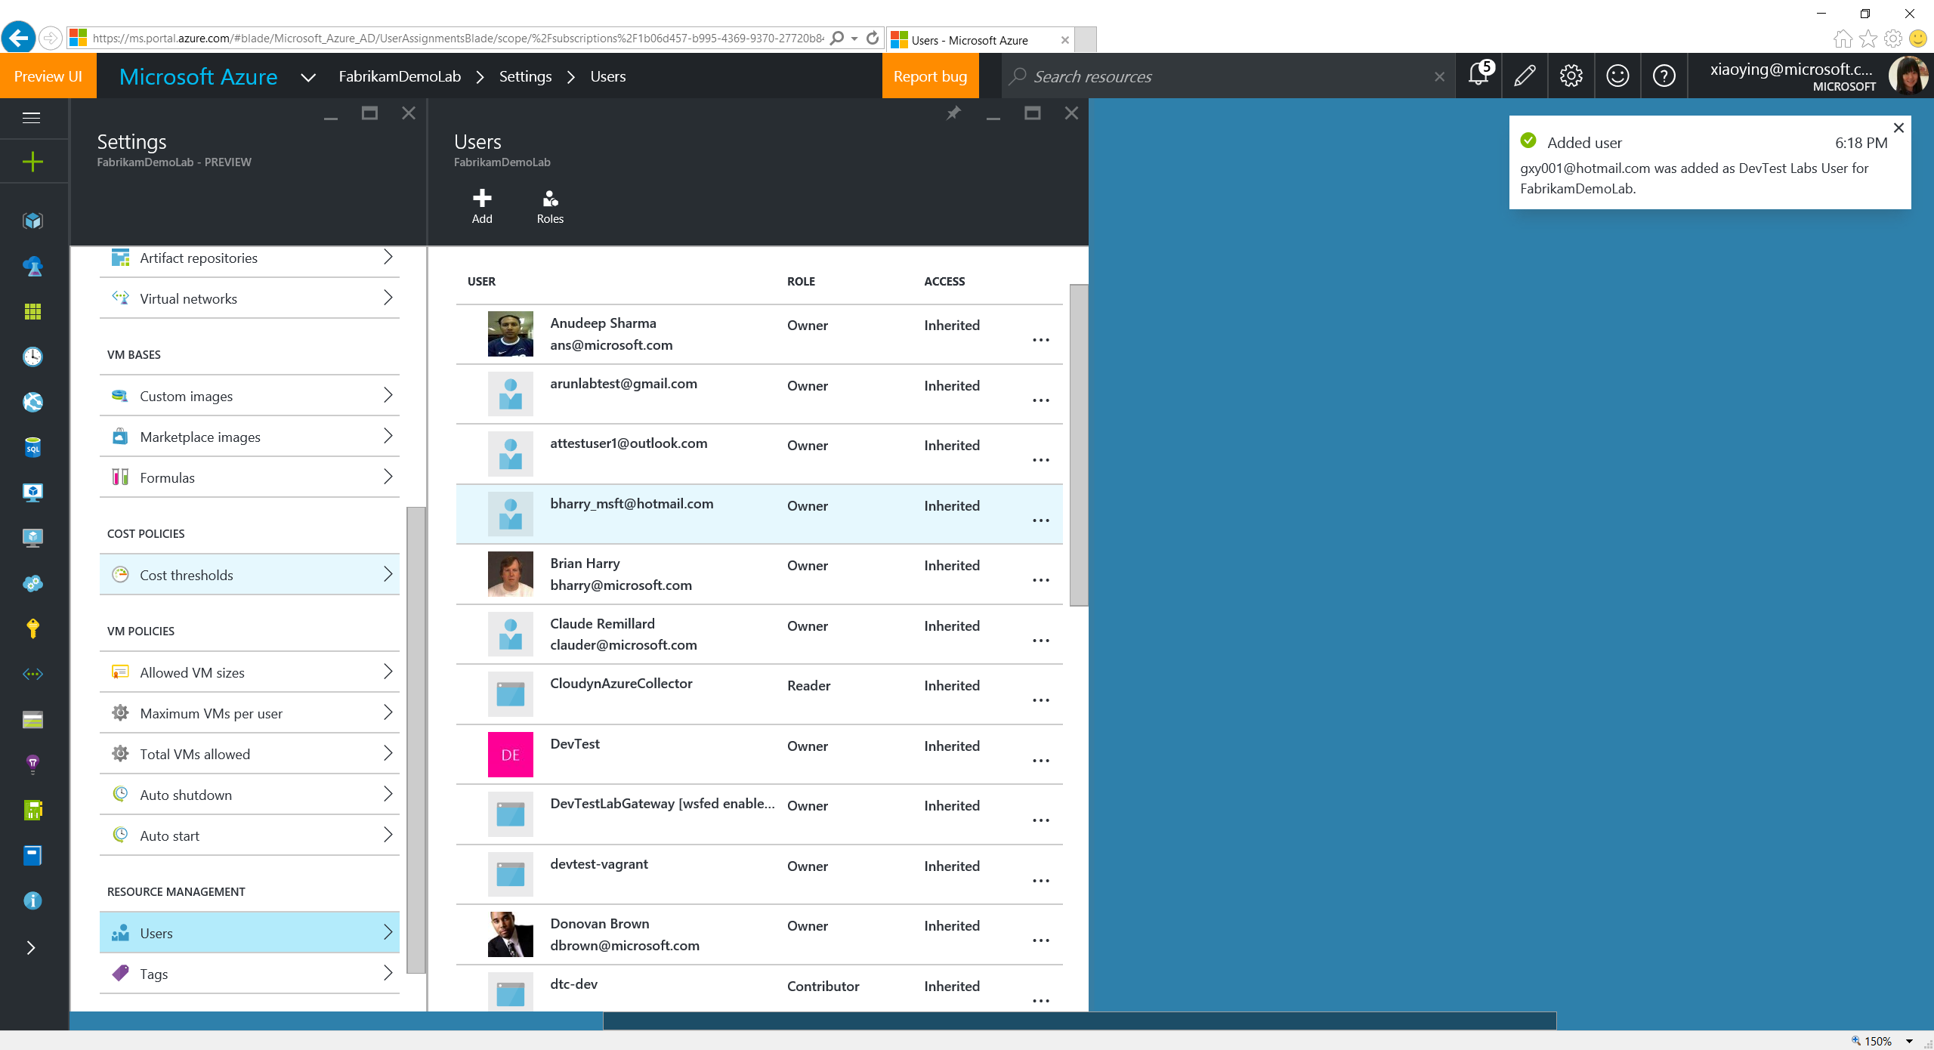
Notes:
User is successfully added.

Slide 45
Create a VM

Slide 46
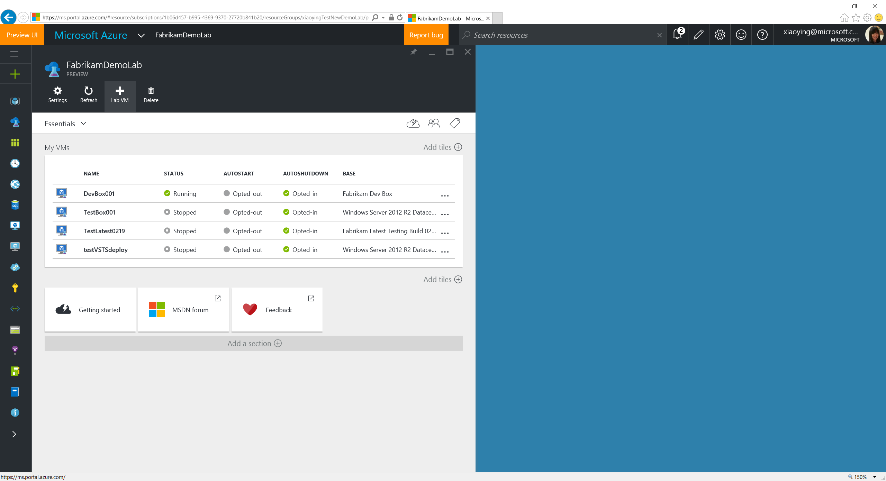
Notes:
Click the Add Lab VM button on the top of the lab blade to create a new VM in the lab.

Slide 47
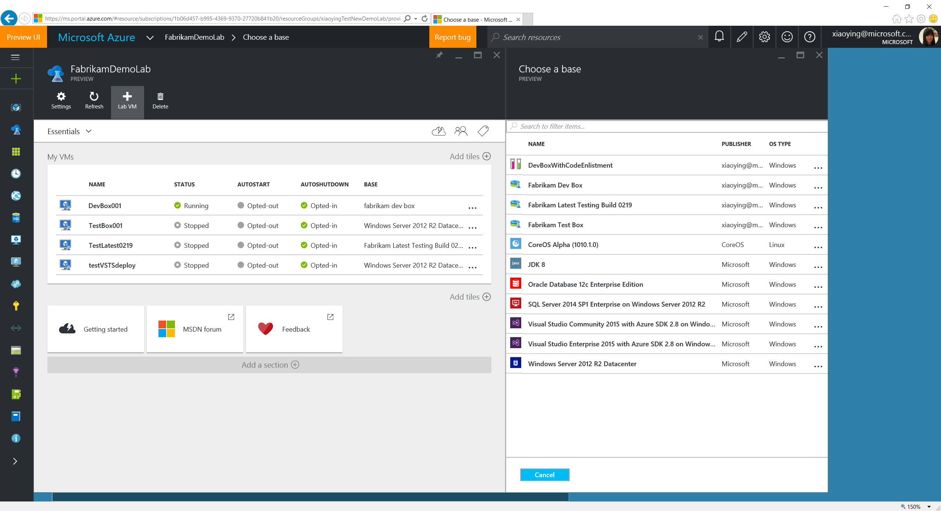
Notes:
Lab VM creation starts with choosing a VM base. The base list consists of formulas, custom images and Azure Marketplace images. Formula is a template with pre-defined values to the lab VM creation settings. Custom images are from the VHDs added into the lab. Lab owner can whitelist Azure Marketplace images allowed to show up in the lab VM base.

Slide 48
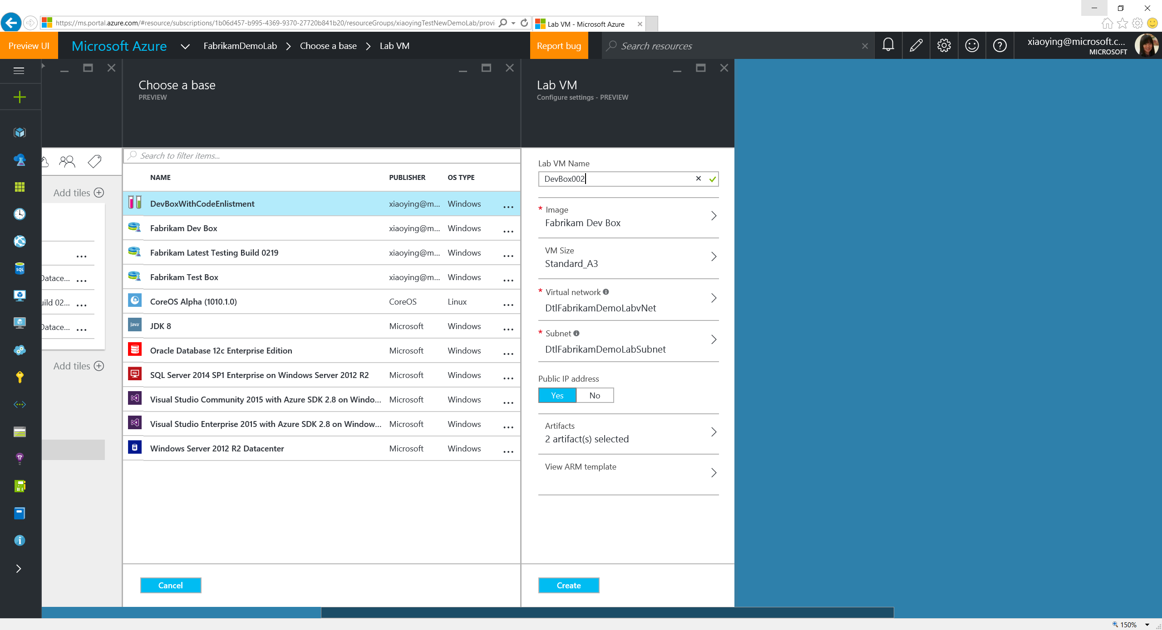
Notes:
Choose a Formula where you can see most of the settings have pre-defined values.

Slide 49
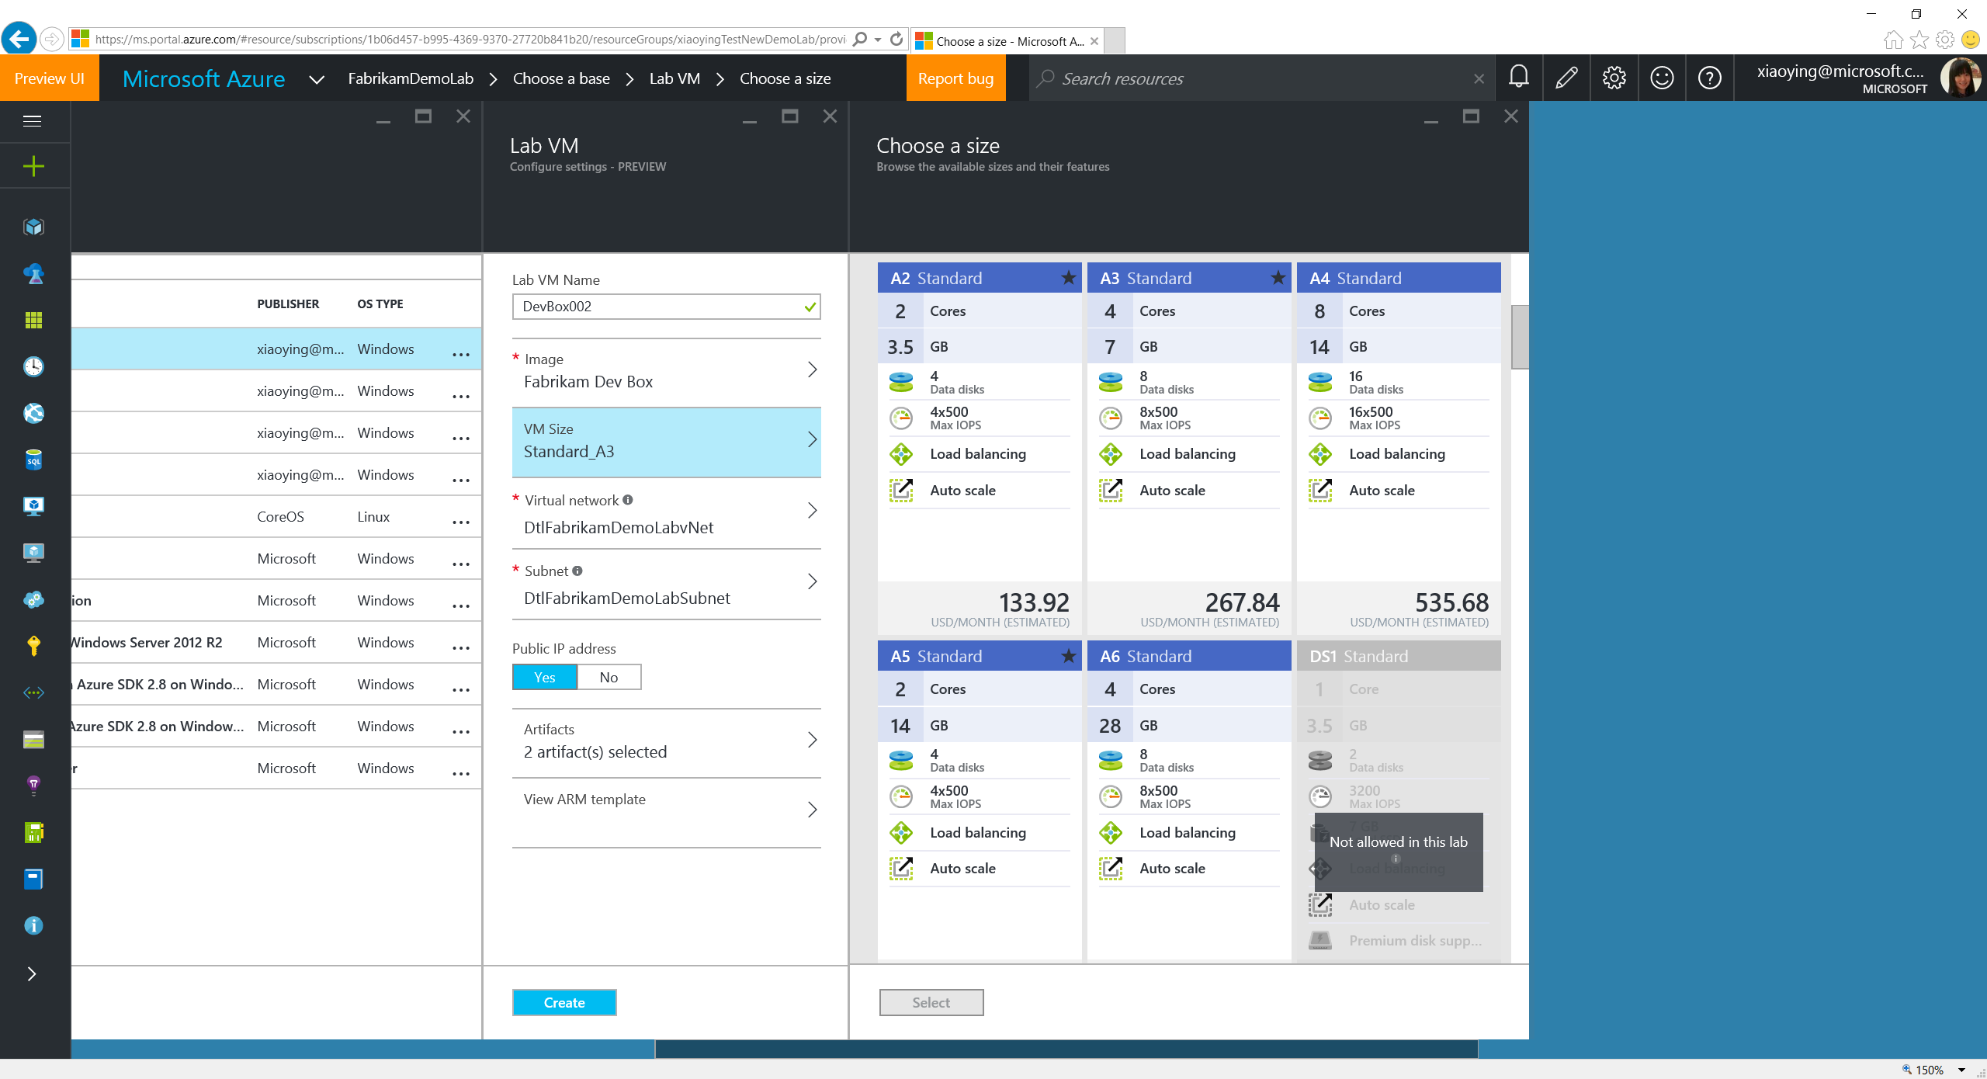
Notes:
Select a VM size. What’s allowed to be selected is based on the Allowed VM Sizes policy set in the lab.

Slide 50
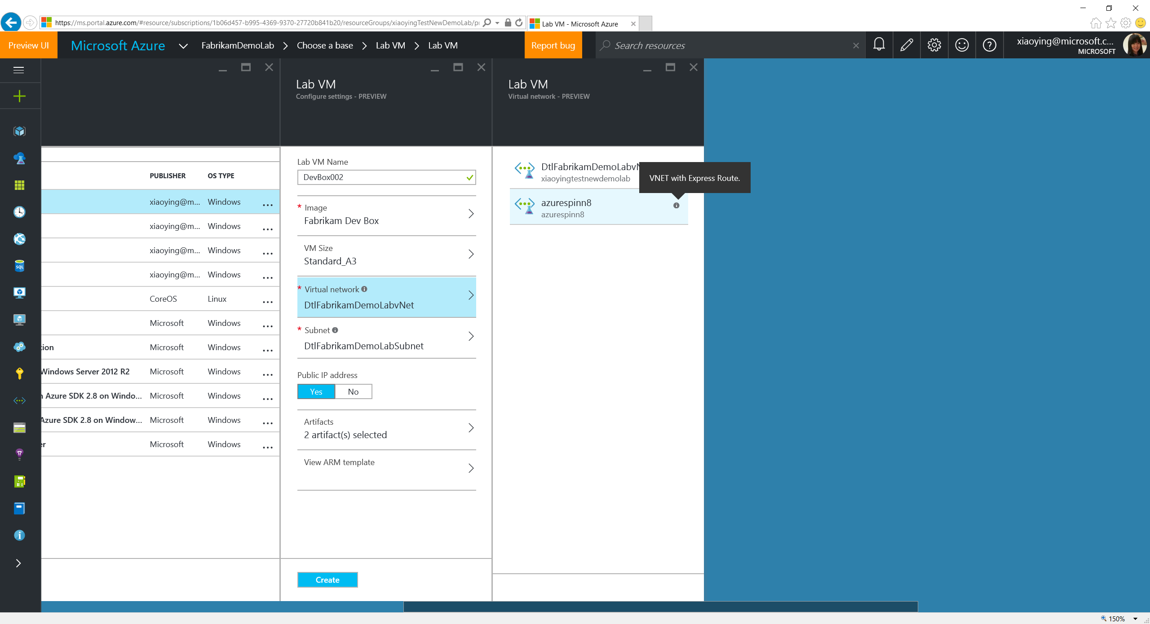
Notes:
Only allowed VNET can be selected.

Slide 51
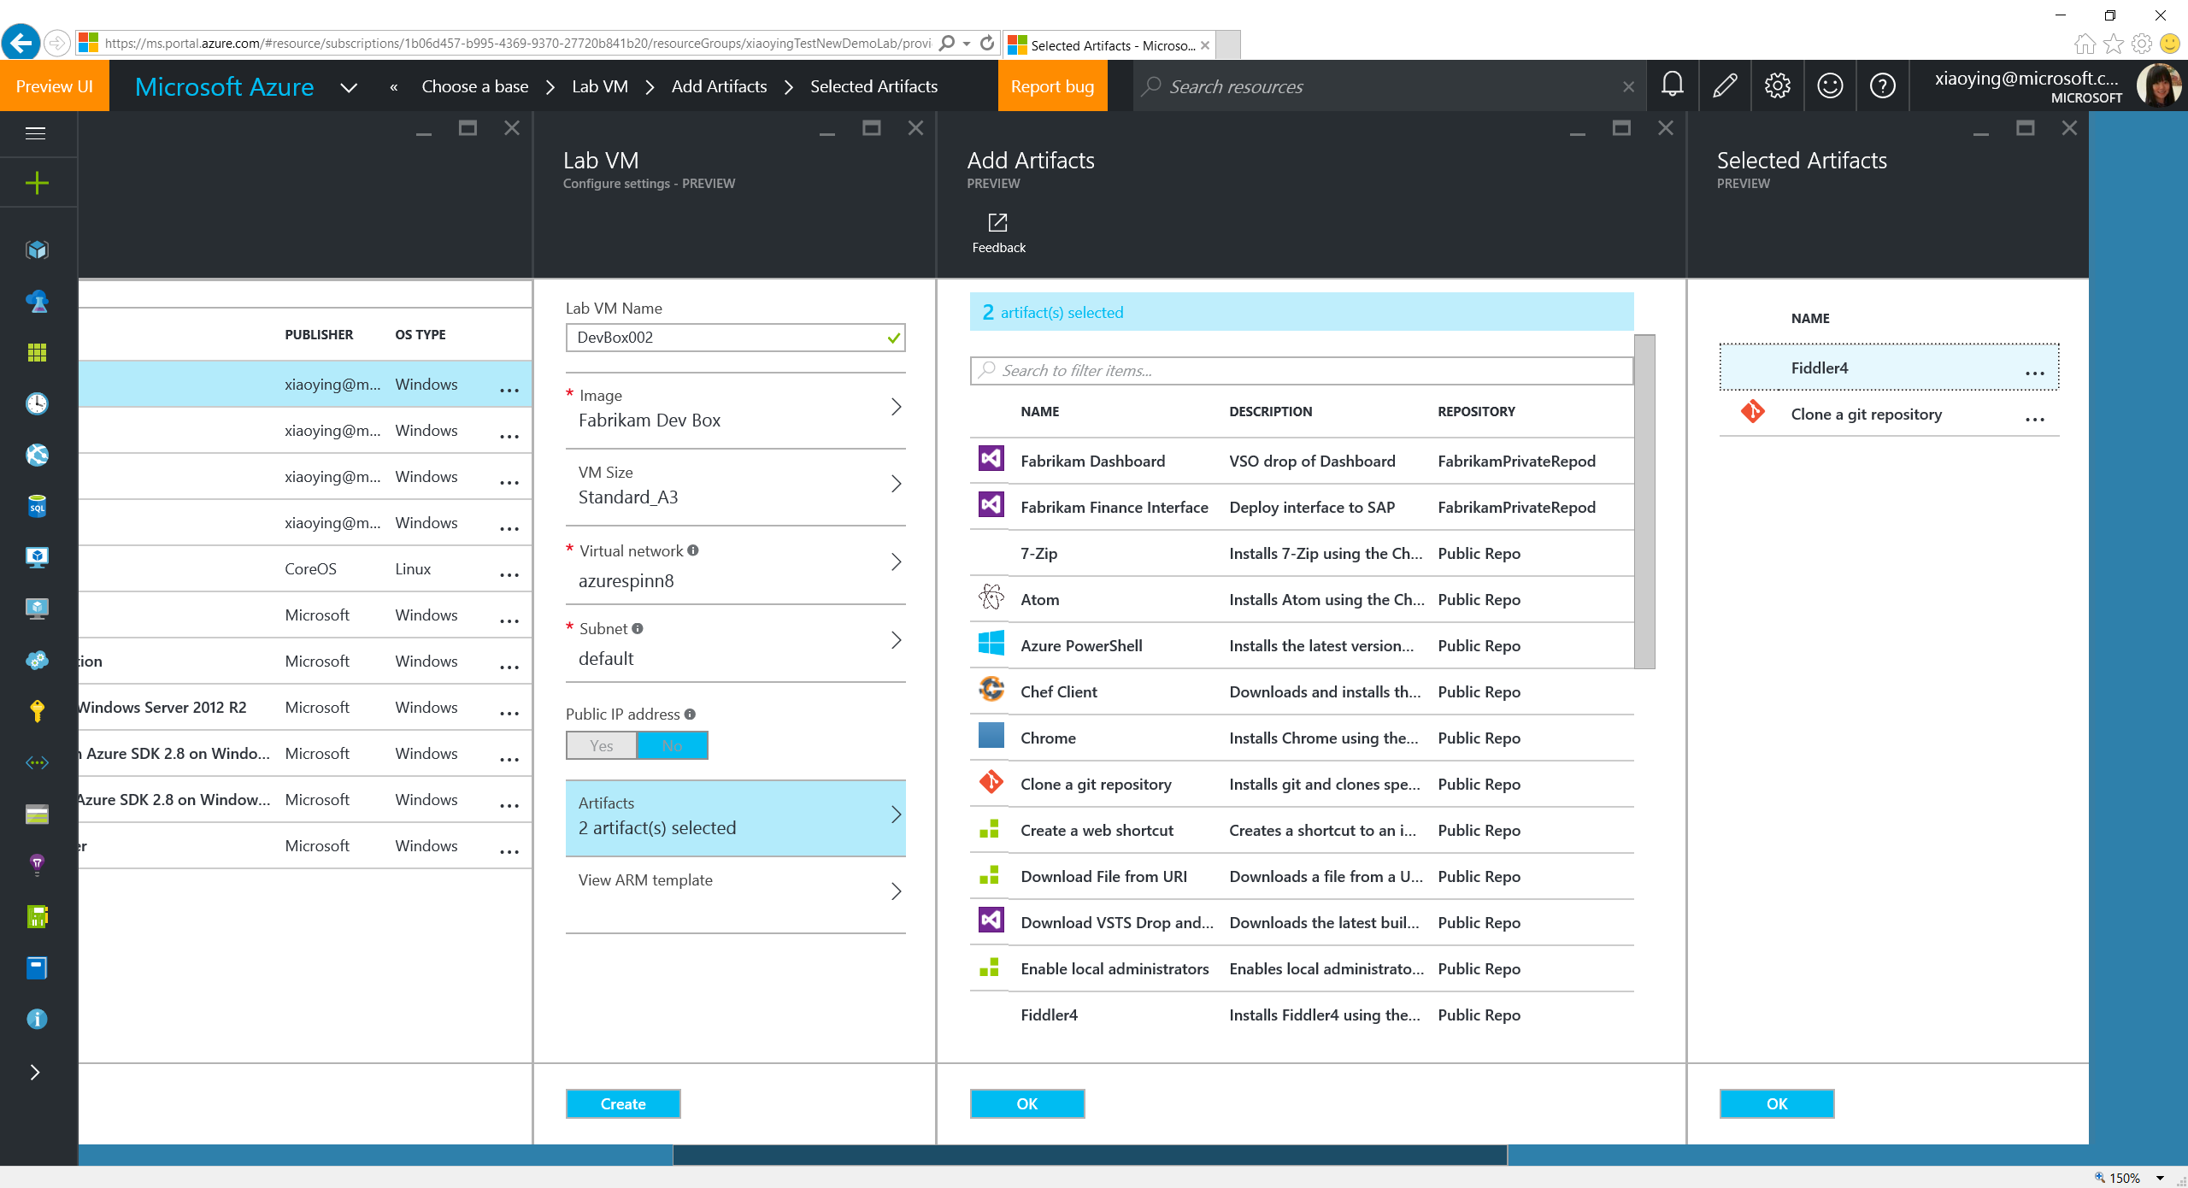
Notes:
2 artifacts have been selected with this Formula to enlist code and install Fiddler4. More can be added and the added one can also be updated based on real needs. In general, artifacts allow you to install apps or run system configurations right after the VM is created with the base image. Labs comes by default with a lot of artifacts stored in a public GitHub repo that you can reuse immediately after a lab is created.

Slide 52
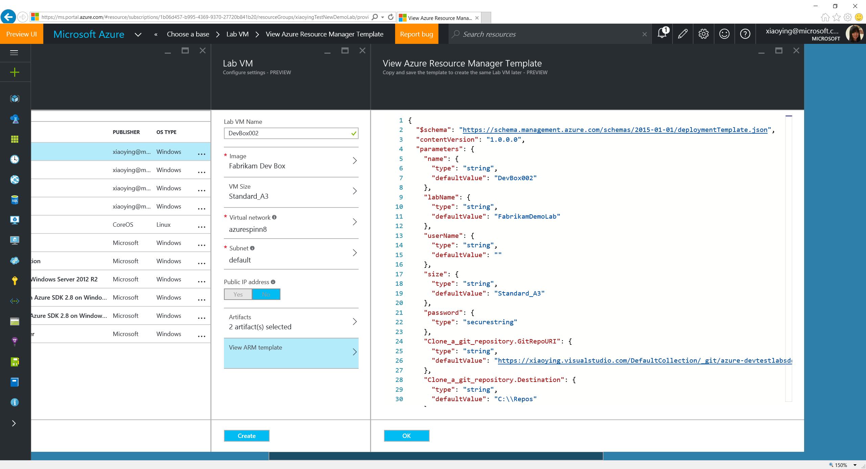
Notes:
You can also view the ARM template content that will be used for this VM creation. You can copy and save it for later reuse (through ARM template deployment) when desired.

Slide 53
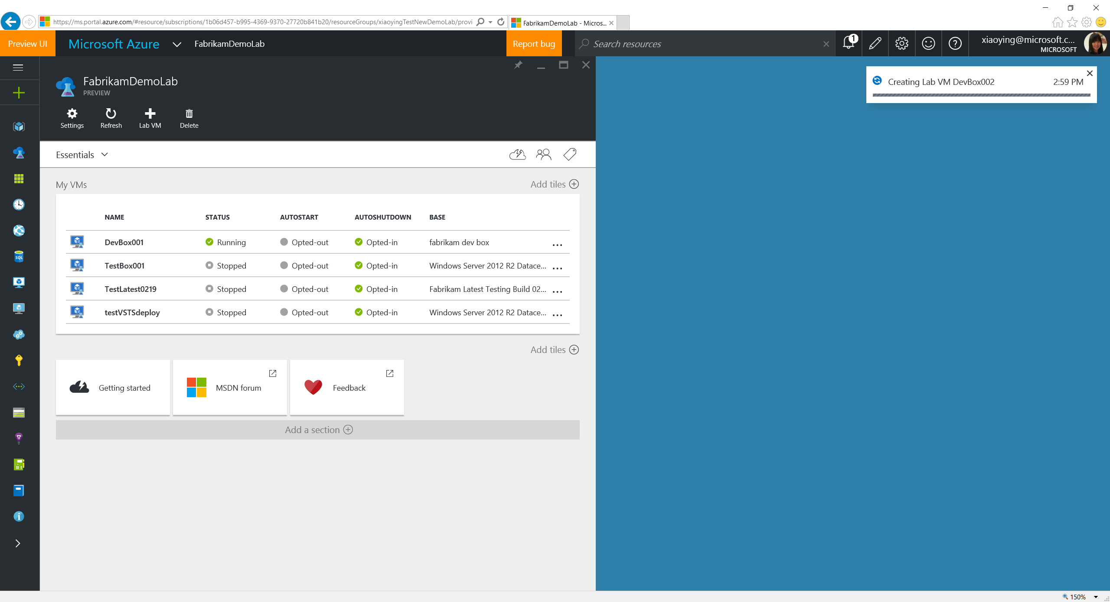
Notes:
Lab creation is in progress…

Slide 54
Manage Existing VMs

Slide 55
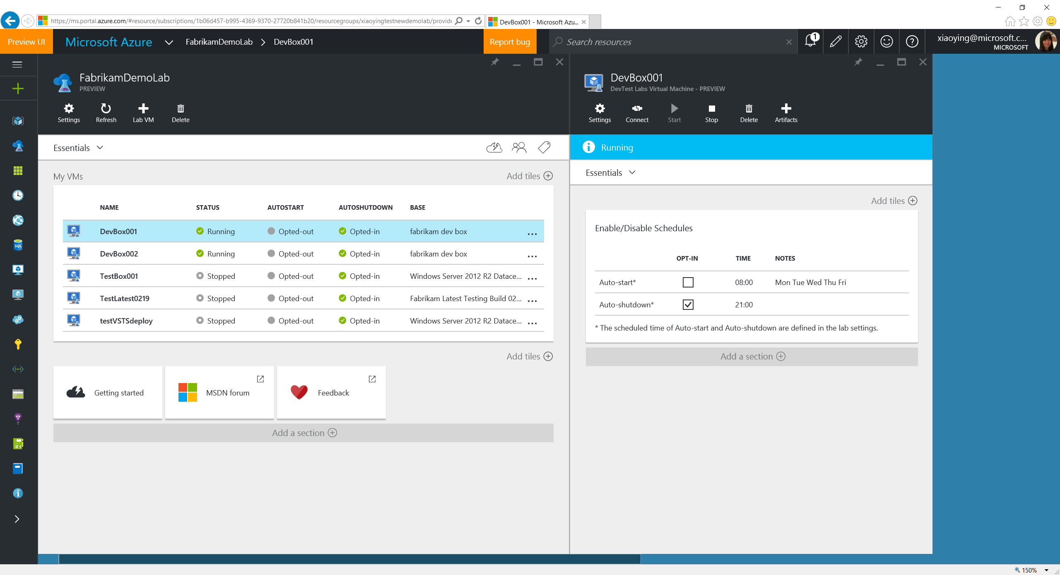
Notes:
Select an existing VM to open the lab VM blade. View the auto-shutdown/auto-start status.

Slide 56
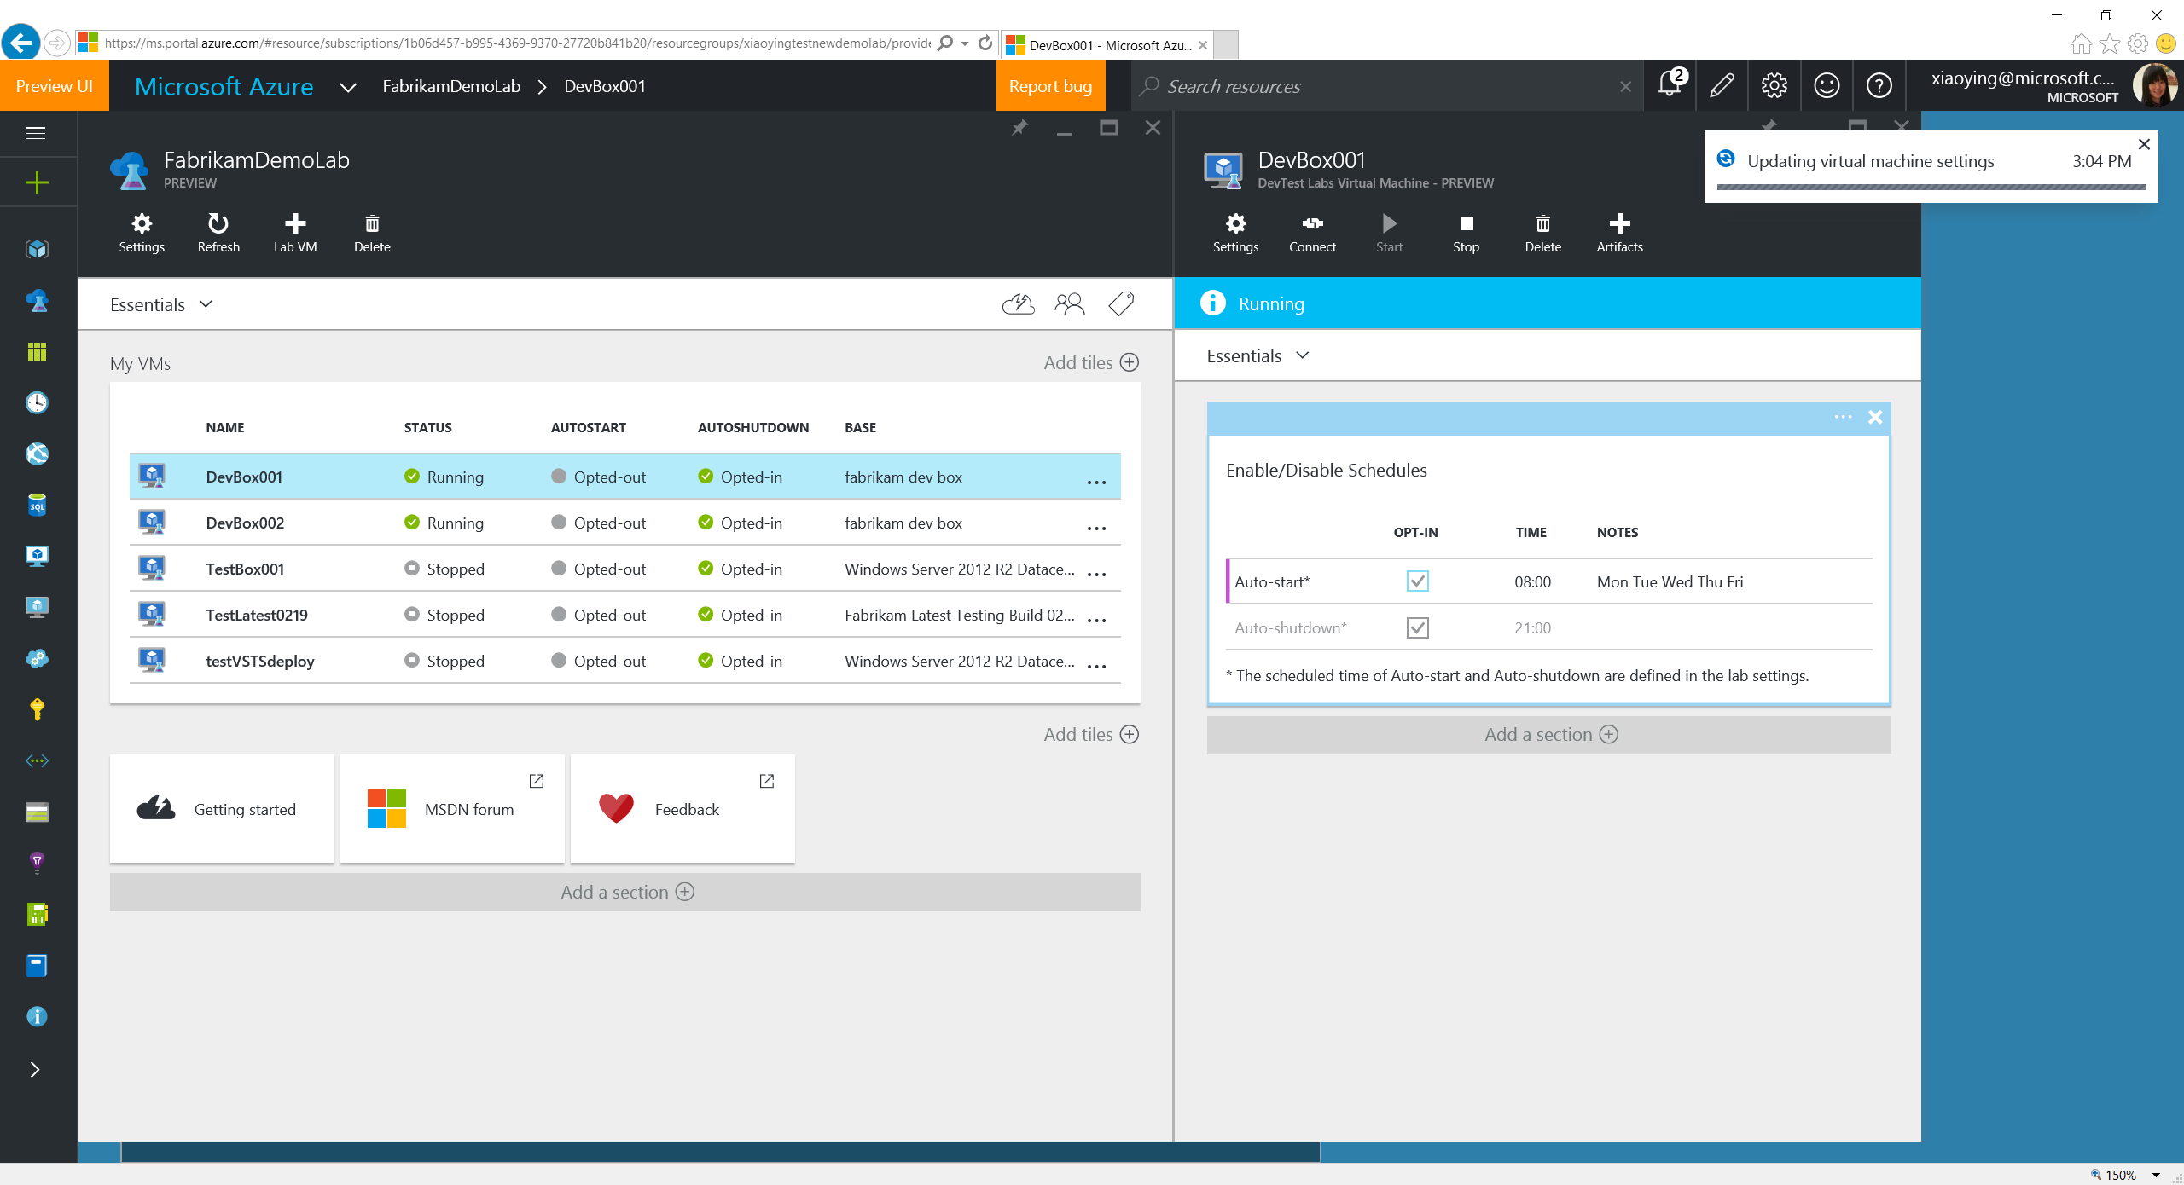
Notes:
Select to opt-in auto-start policy. Users can also select to opt-in/out auto-shutdown/start policies here.

Slide 57
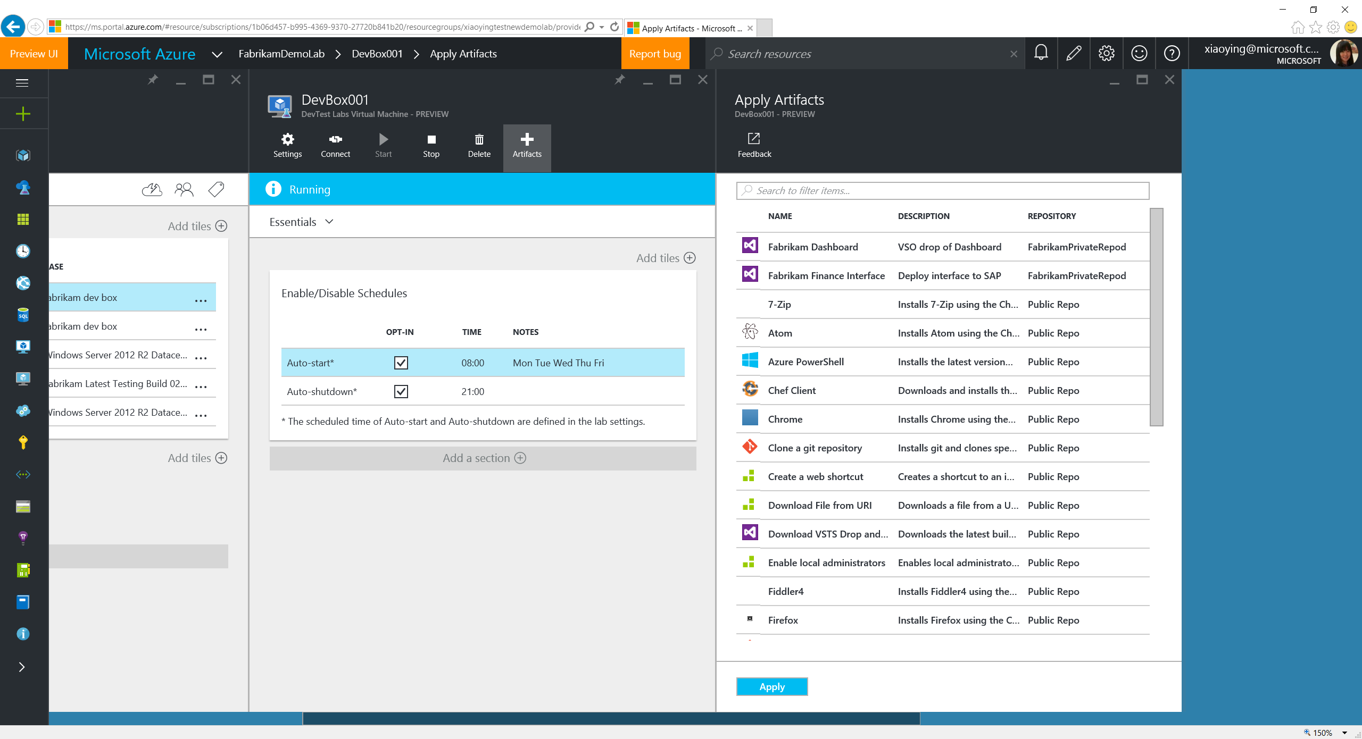
Notes:
Select “+ Artifacts” to install more apps or run configurations onto the VM (e.g. add a Docker container for new tests, install a new Dev tool that helps debugging) through artifacts without tedious manual operations.

Slide 58
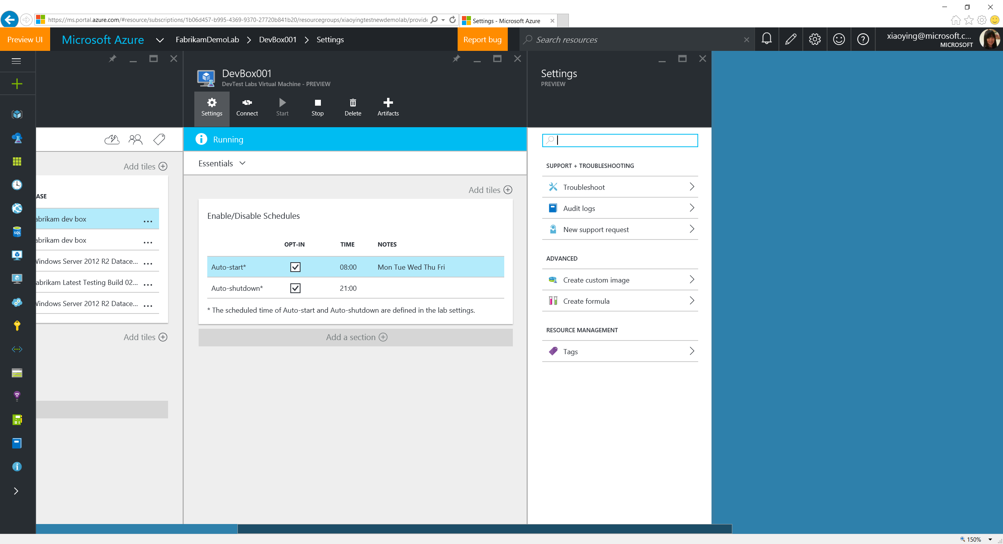
Notes:
Lab VM blade Settings allow to create custom image or formula from the VM, to add tags or do troubleshooting.

Slide 59
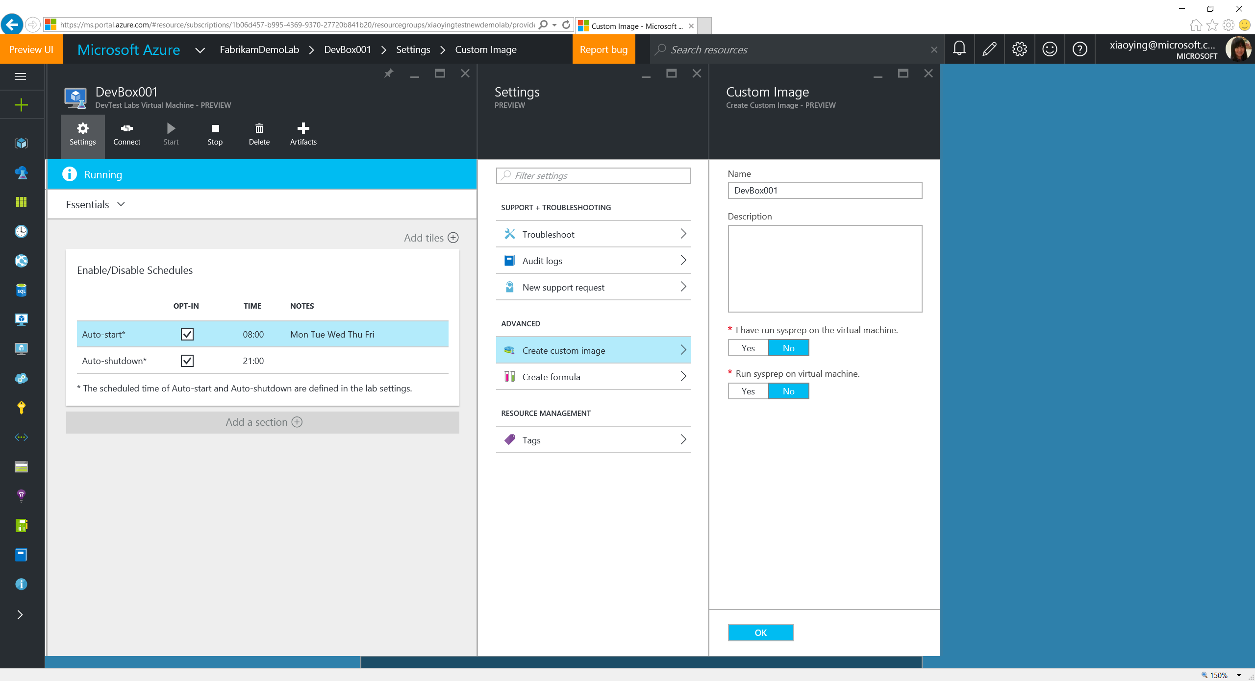
Notes:
Create a custom image from the existing lab VM. The image will be saved in the lab and become available to all the lab users to create VMs.

Slide 60
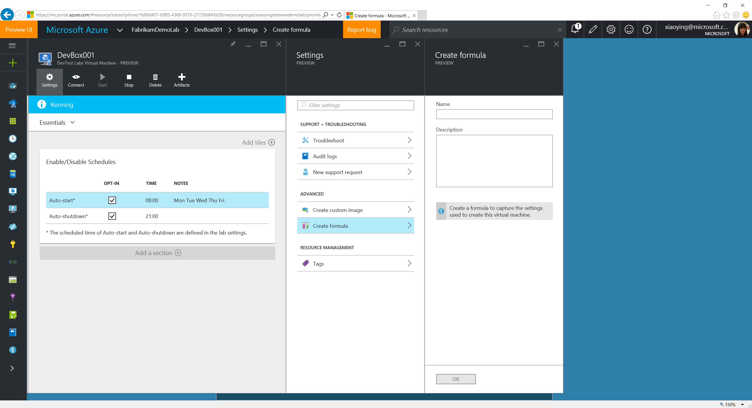
Notes:
Or, simply create a formula, which is a template file that stores all the setting values used when this VM is being created (except the secure strings). It saves the storage space, and allow artifacts to play a role for installing things that can change over the time.

Slide 61
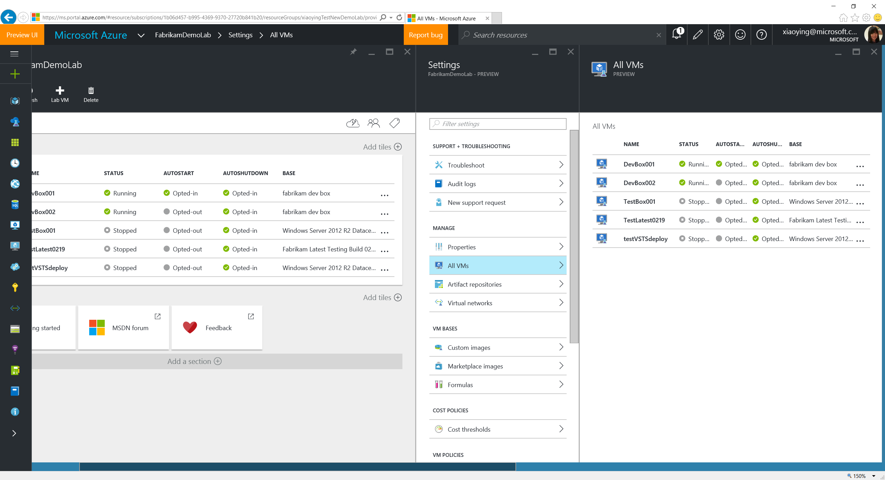
Notes:
A view for all the VMs is available through lab Settings -> All VMs.

